Slide 1

Circular economy for real closing the phosphorus cycle
Sara Stiernström 2022-03-31

Slide 2
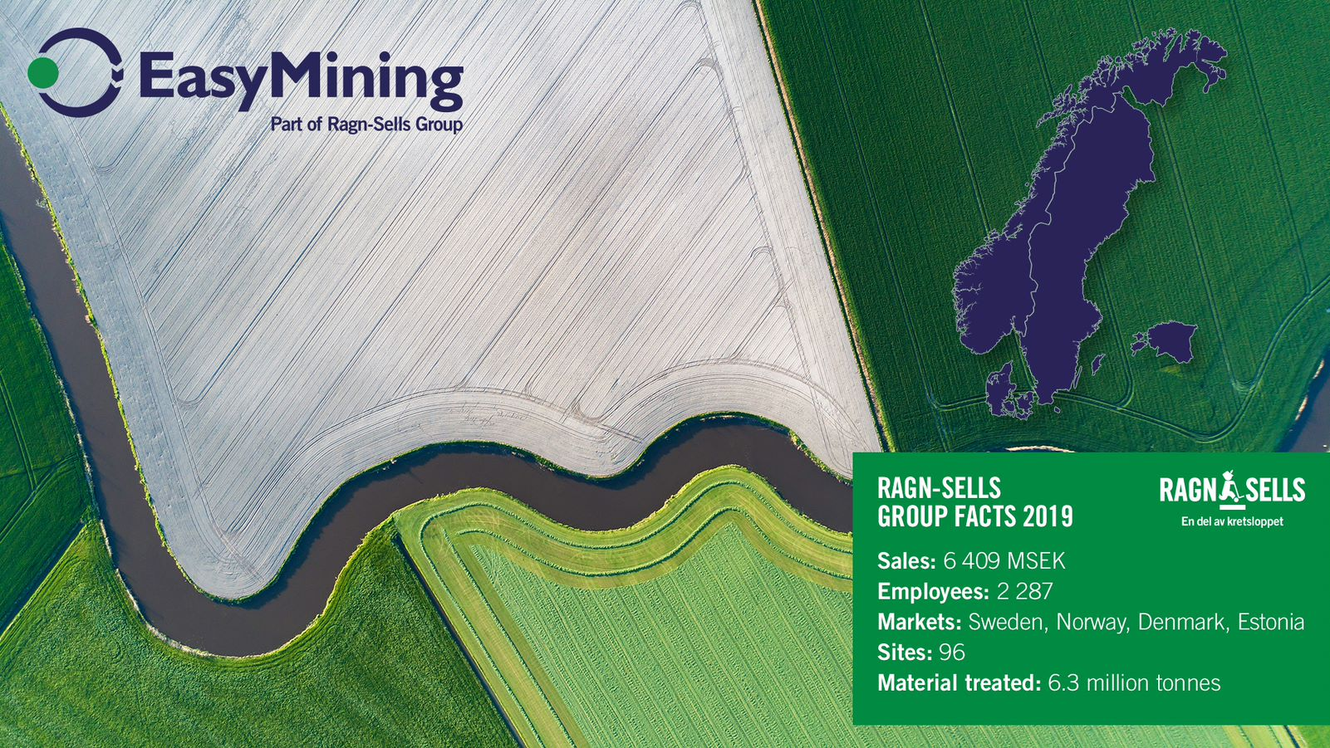

Slide 3

Production for the future
Closing nutrient cycles
P
K
NP
N
ASH2PHOS
Phosphorus extraction from sewage sludge ash
ASH2SALT
Salt extraction from fly ash
CLEANMAP
Energy efficient production of ammonium phosphate
PROJECT NITROGEN
Recovery of nitrogen from liquid waste streams

Slide 4


Ash2©Phos
From sewage sludge ash
to clean feed phosphate

Slide 5
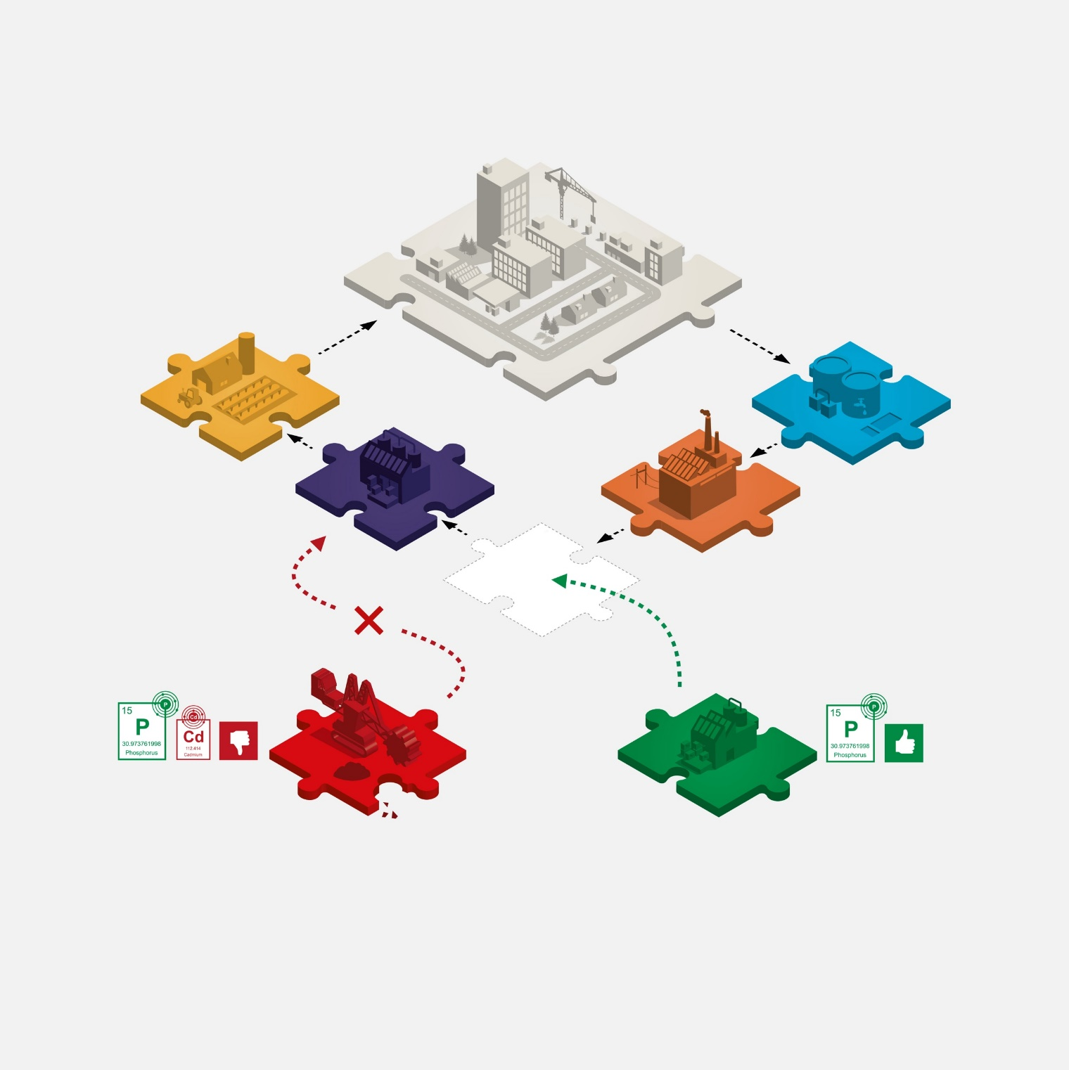
Circulating resources is key
Phosphate Mining
Fertilizers made from phosphate rock naturally contains cadmium that can accumulate in the soil. Phosphate mining is causing damage to the environment, food security and the local economy. Phosphate mining also requires international long distance shipping.
Phosphorus Recovery
Through Phosphorus Recovery, resources are circulated and create a closed loop. Phosphorus recovery can be produced locally.
Society
Agriculture
WWTP
Production Industry
Incineration Plant
Phosphate Mining
Phosphorus Recovery

Slide 6
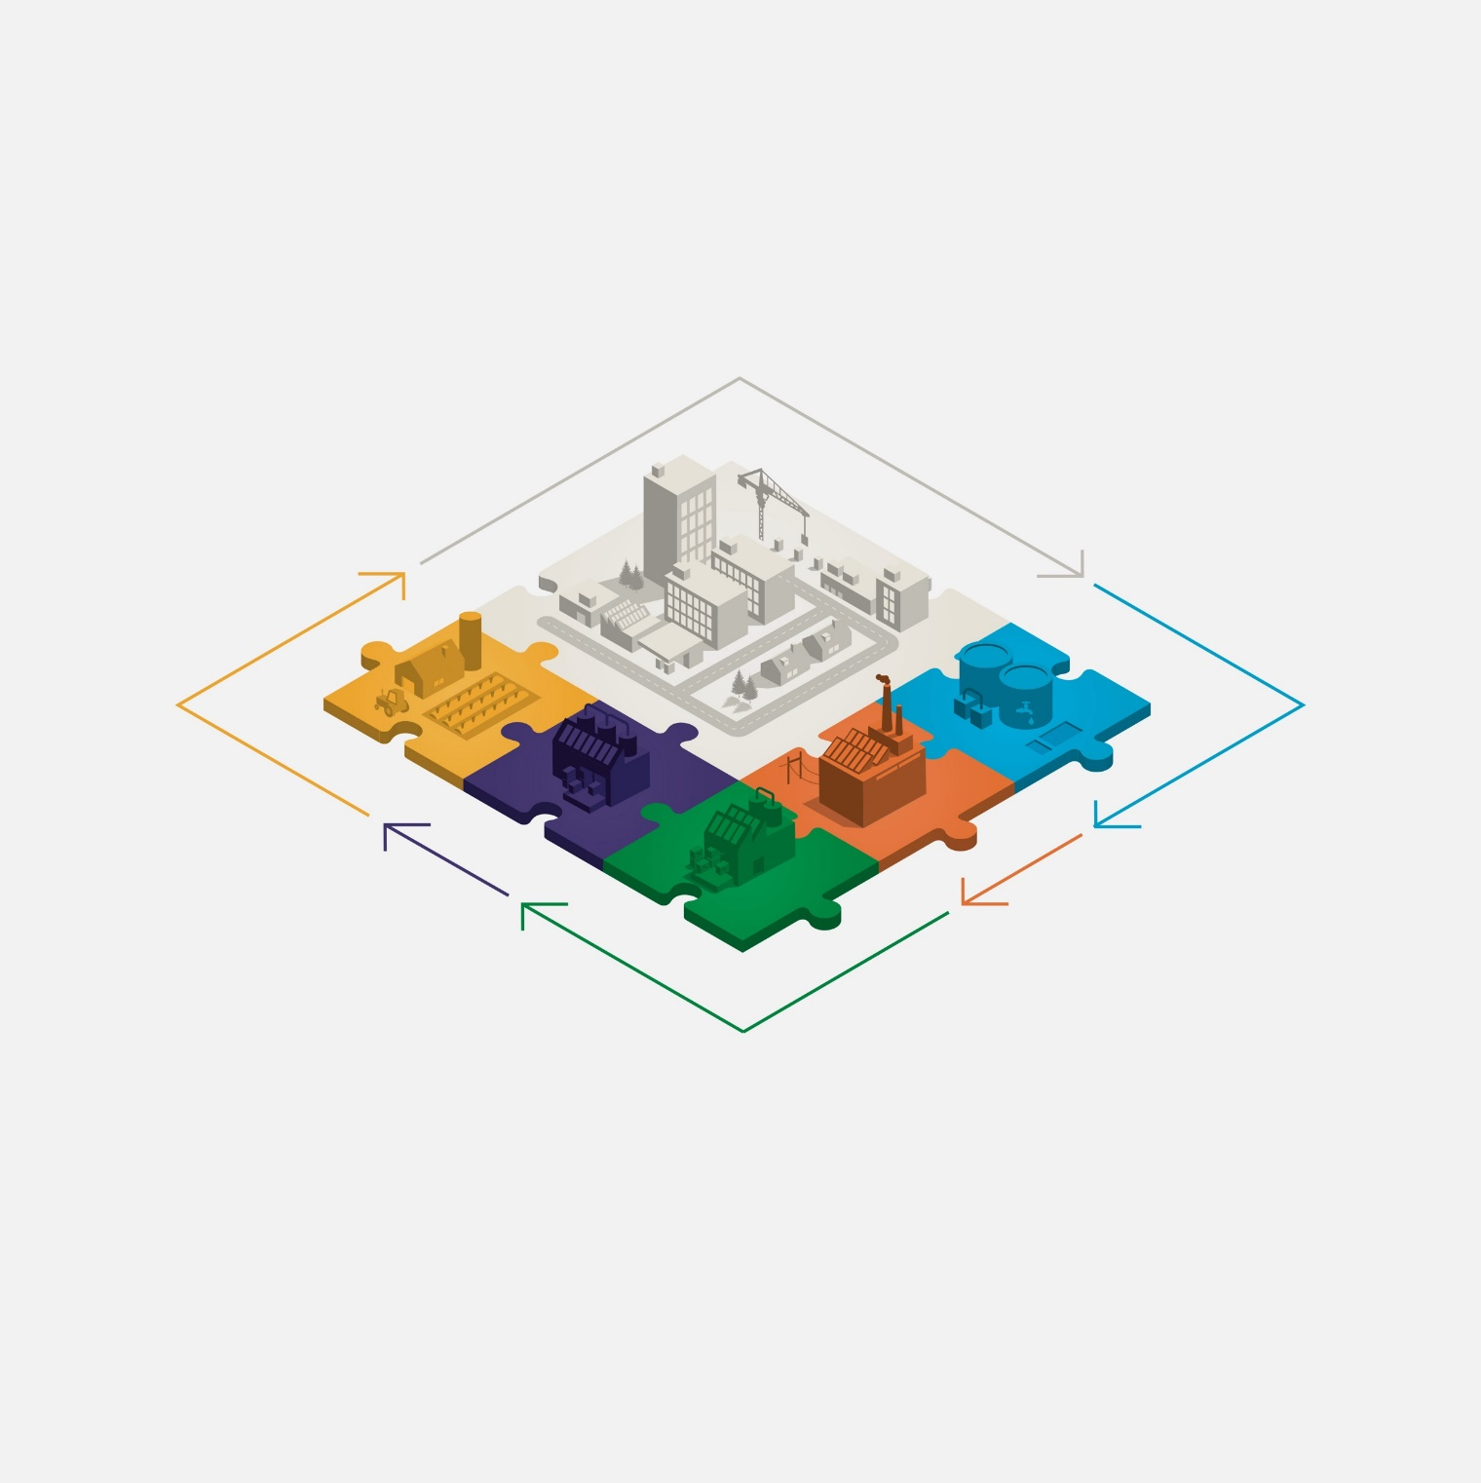







A Closed loop
Society
With phosphorus recovery, we add the missing piece allowing us to collaborate and create
circular economy for real.
Food is consumed → wastewater
Wastewater is purified, creating a by-product: Sludge
Sludge is incinerated (green energy), creating a raw material: Fly ash
Fly ash is detoxified through the Ash2®Phos process
→ extraction of clean phosphorus
Phosphorus turned into clean commercial products, a feed phosphate
New food is produced
Agriculture
WWTP
Production
Industry
Incineration
Plant
Ash2®Phos
Phosphorus Recovery

Slide 7
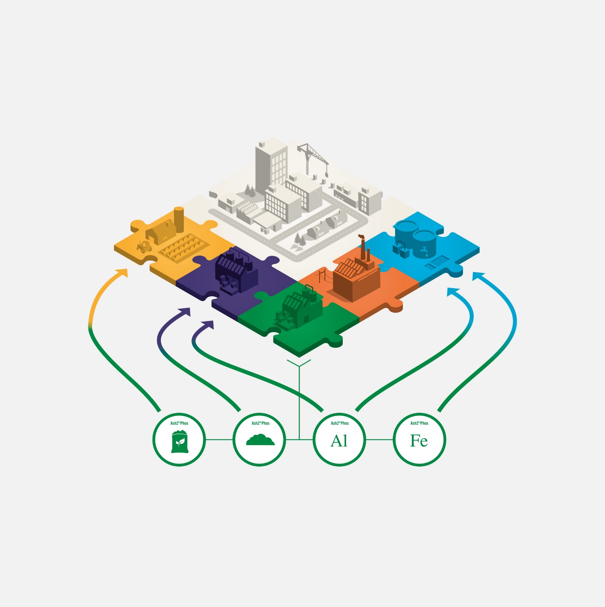

Products ash2®phos
Environmental benefits
Recovery of clean, defined and commercial phosphorus products
Recovery of Fe and Al based chemicals for i.e. wastewater treatment plants
Circular flows of quality improved resources
Reduced need for virgin rock phosphate
Detoxified material
Favourable mass balance
Energy efficient process
Real waste reduction
Agriculture
WWTP
Production
Industry
Clean
phosphorus
products
Silica
sand
Precipitation
chemical:
Aluminium
Precipitation
chemical:
Iron

Slide 8
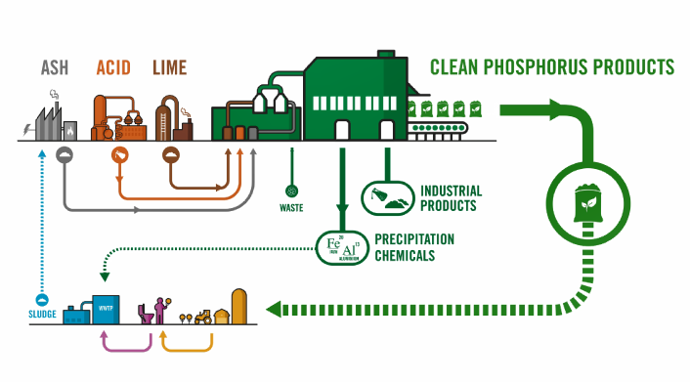
Ash2Phos process

Slide 9
Precipitated Calcium Phosphate (PCP)
KEY PARAMETERS IN PCP | VALUE
Phosphorus (P) | 17%
Calcium (Ca) | 35%
DS | 95%
Formula | Ca₅(PO₄)₃OH
Cas No | 12167-74-7
PARAMETER | PCP TYPICAL VALUE | ROCK PHOSPHATE TYPICAL VALUE
Phosphorus (P) | 16-17 % | 13.5 – 14.5 %
Arsenic (As) | 1.4 mg/kg | 12.2 mg/kg
Cadmium (Cd) | < 0.1 mg/kg | 13 mg/kg (89-96 mg/kg P)
Chromium (Cr) | 1.7 mg/kg | 236 mg/kg
Cobolt (Co) | 0.41 mg/kg | 0.8 mg/kg
Fluorine (F) | 0.014 mg/kg | 20 000 – 40 000 mg/kg
Lead (Pb) | 3.6 mg/kg | 6.4 mg/kg
Mercury (Hg) | < 0.1 mg/kg | Not stated
Nickel (Ni) | 2.5 mg/kg | 48 mg/kg
Strontium (Sr) | 135 mg/kg | 1466 mg/kg

Slide 10
Legal limits on undesirable elements in feed phosphates in the EU
KEY PARAMETERS IN PCP | VALUE
Phosphorus (P) | 17%
Calcium (Ca) | 35%
DS | 95%
Formula | Ca₅(PO₄)₃OH
Cas No | 12167-74-7
ELEMENT | LEGAL LIMIT* | PCP TYPICAL VALUE
Fluorine | 2000 ppm | 0.014 ppm
Cadmium | 10 ppm | < 0.1 ppm
Arsenic | 10 ppm | 1.4 ppm
Mercury | 0.1 ppm | < 0.1 ppm
Lead | 15 ppm | 3.6 ppm
Dioxins | 0.75 ppb | < 0.1 ppb
PCB | 10 ppb | < 0.1 ppb
* Source: EU Directive 2002/32/EC, 2003/57/EC and 2006/13/EC

Slide 11
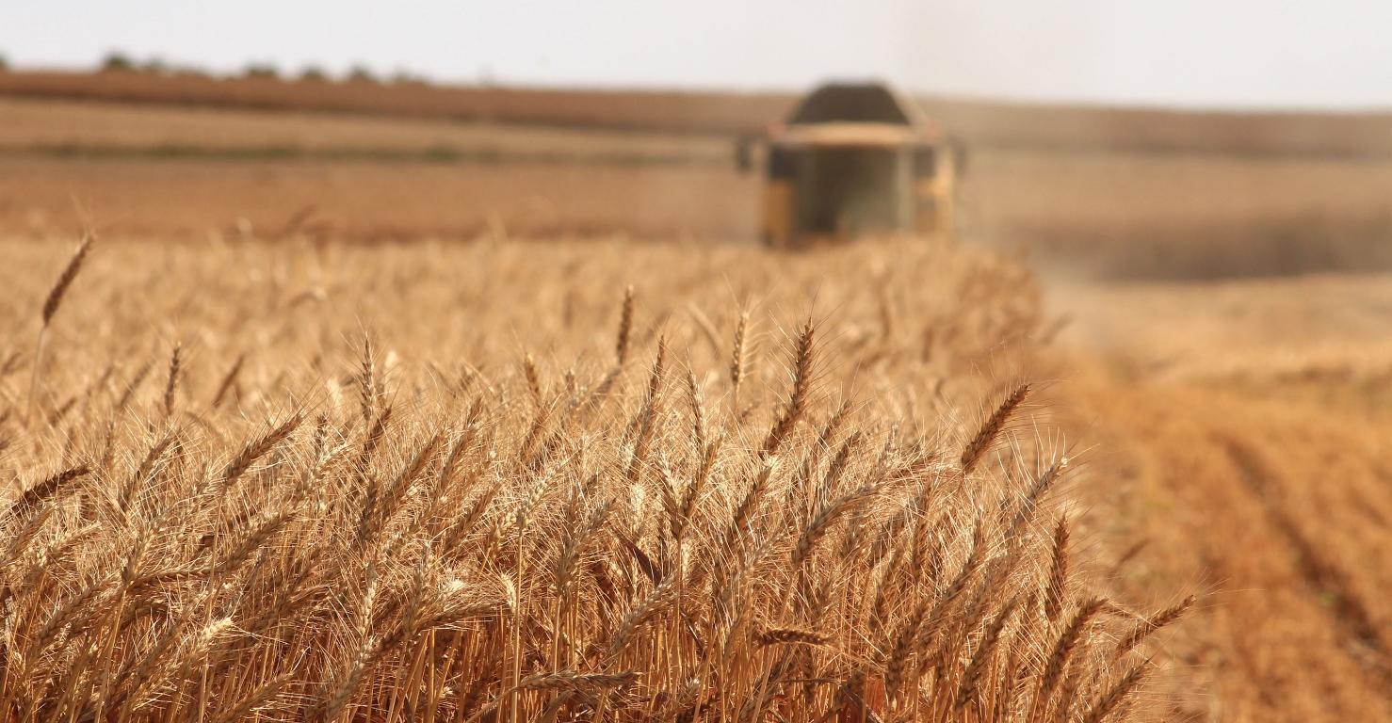
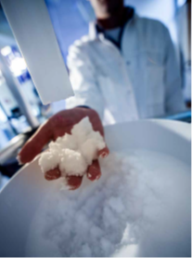


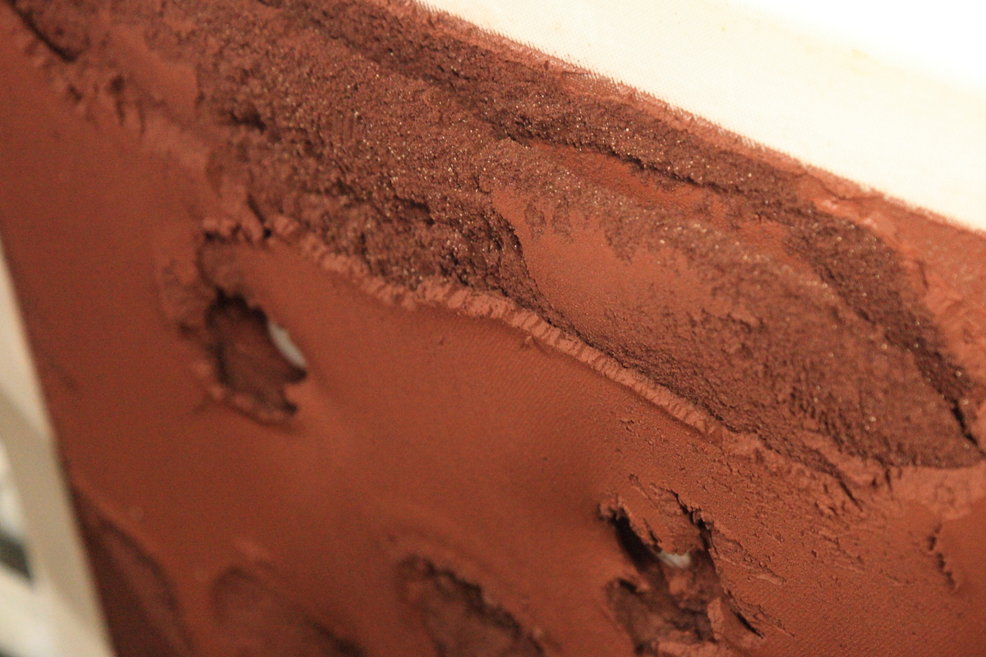

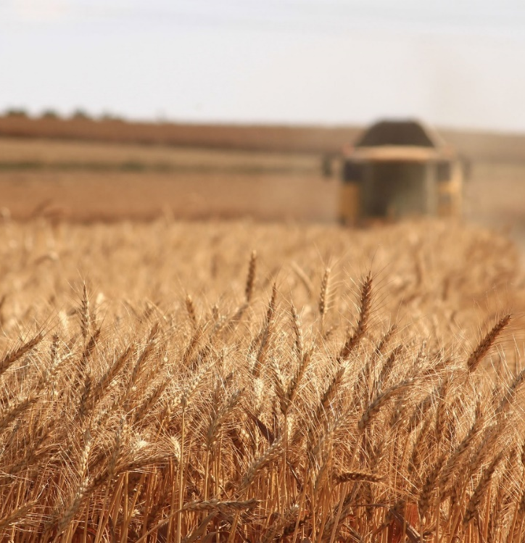
Recovered Phosphorus for animal feed
Utilising the Ash2®Phos process to recover phosphorus from incinerated sludge ash
PCP as feed phosphate:
  CO₂ savings
  Fully soluble in citric acid
  No contaminants
  Digestibility tested on pigs and poultry with good results
  Legislation barrier
Read more
Recycled phosphorus as feed phosphate (easymining.se)
Notes:
The Ash2Phos process is based on wet processing of the sewage sludge ash for recovery of phosphorus, iron and aluminium in form of commercial products. Phosphorus is recovered in form of clean calcium phosphate used for fertiliser or feed applications. Iron and aluminium are recovered separately in form of ferric chloride and sodium aluminate to be re-used as coagulants in wastewater treatment.
PCP (xxxx
MCP (xxxx

Slide 12
LEGISATION PUSHING RECYCLED AND HIGH-QUALITY PHOSPHORUS
The EU Taxonomy on sustainable financing: pushing for 80% recovery of P from WWTP and demand on purity in the final product
The new Sewage Sludge Directive: pushing for decontamination of sewage sludge via quality limits on sludge use
The new Urban Wastewater Treatment Directive: push for recovery demands on P from WWTPs.
EU Soil Strategy; pushing for zero pollution and non-toxic soils
Carbon Border Adjustment Mechanism: Will redefine value chains, favor domestic P by adding a tax on imported P from outside Europe
Society
Agriculture
WWTP
Production
Industry
Incineration
Plant
Phosphorus Recovery

Slide 13


LEGISATION BARRIERS FOR RECYCLED PHOSPHORUS
Regulation 767/2009 on the placing on the market and use of feed:
  a product recycled from sewage sludge to be used in animal feed is prohibited*
Society
Agriculture
WWTP
Production
Industry
Incineration
Plant
Phosphorus Recovery
*ANNEX III Point 5: List of materials whose placing on the market or use for animal nutritional purposes is restricted or prohibited as referred to in Article 6: All waste obtained from the various phases of the treatment of the urban, domestic and industrial waste-water

Slide 14
THE WAY FORWARD
Open the legisation: focus on quality instead of origin
Legislative incentives for the production industry
Quota system
Make ash a safe starting point
Society
Agriculture
WWTP
Production
Industry
Incineration
Plant
Phosphorus Recovery

Slide 15
ASH2PHOS – products
Ash2Phos results in clean, well known products where the input chemicals become part of the final product. Products are effective in their applications.
Products from the process >95% can be used
Phosphorus
  Precipitated Calcium Phosphate (PCP)
  Converted PCP: MAP, SSP, DCP, MCP
Precipitation chemicals
Iron Chloride
Aluminium product
Silica sand
Notes:
The Ash2Phos process is based on wet processing of the SSA for recovery of phosphorus, iron and aluminium in form of commercial products. Phosphorus is recovered in form of clean calcium phosphate used for fertilizer or feed applications. Iron and aluminium are recovered separately in form of ferric chloride and sodium aluminate to be re-used as coagulants in wastewater treatment.

Slide 16
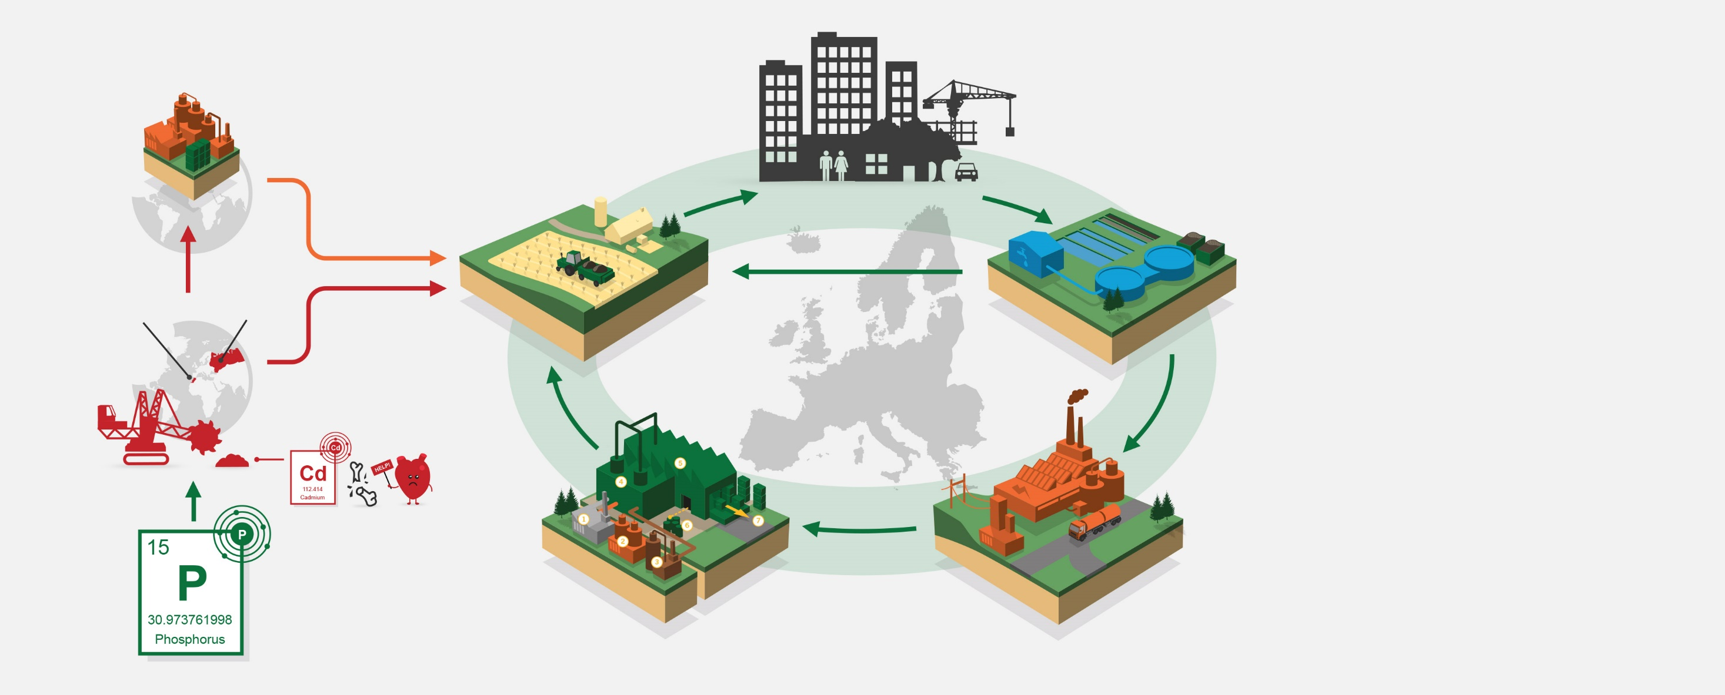
Our ambitions
Decontamination of aqueous phase by contaminants transfer and accumulation in sludge
CLEAN NITROGEN PRODUCTS
CLEAN PHOSPHATES
P, Fe, Al, Si, Ca
Recovery
HM detoxification
Energy recovery, decontamination (organics)
Concentration (minerals)

Slide 17
Two Digestibility Studies
Growing pigs and chickens
Determine the phosphorus digestibility of recycled precipitated calcium phosphate (PCP)
Hypothesis: PCP should have a similar phosphorus digestibility as monocalcium phosphate (MCP) in pigs and chickens

Slide 18
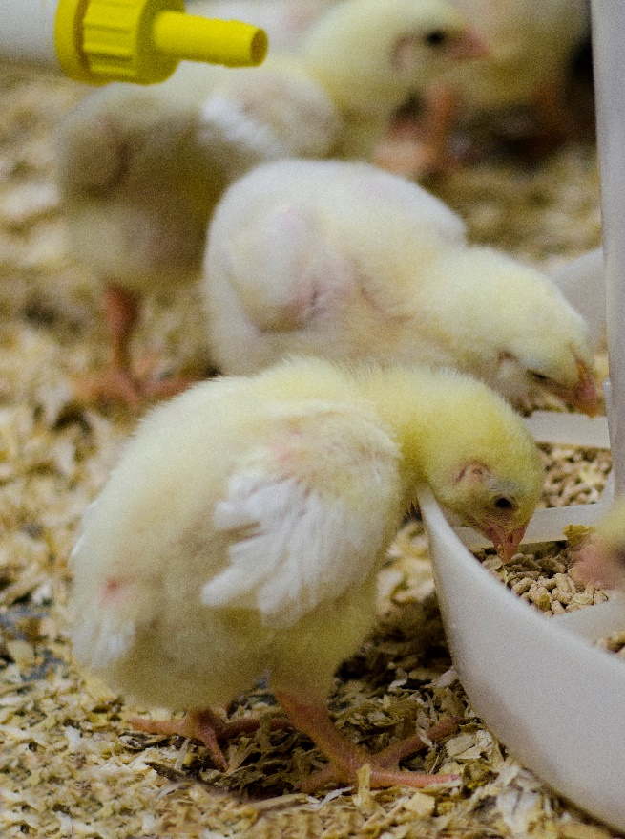
Chicken study
240 day old chicks (Ross 308) divided in 30 groups - 8 chickens/group
At day 21: Five experimental diets (6 groups/diet)
  Basal diet (WPSA, 2013)
  Test diet PCP low (total P level 0.075%)
  Test diet PCP high (total P level 0.15%)
  Test diet MCP low (total P level 0.075%)
  Test diet MCP high (total P level 0.15%)
Photo: E. Ivarsson
Notes:
Used 240 day old chicks
In accordance with the suggested method to determine the digestibility of P in chickens, five experimental diets were composed.
A basal diet was used to fulfil the protocol requirements stated in WPSA, 2013 (Worlds Poultry Science Association)
In addition, two test diets for each of the two test sources, PCP and MCP were composed with the aim to achieve an increase in the total phosphorus level in the diet compared to the basal diet
with 0.075 % (low) and 0.15% (high), respectively

Slide 19
Chicken study
Day 21-28
Diet 1
Basal
Slaughter and collection of ileal digesta
Diet 2
PCP low
Diet 3
PCP high
Diet 4
MCP low
Diet 5
MCP high
Photo: E. Ivarsson

Slide 20

Pig study
Eight (9-w old) gilts (YxH) from two litters
Randomly divided within litter into two treatment groups
  Test diet PCP
  Test diet MCP
  Basal P-free diet (prior to test diet for endogenous P-losses)

Slide 21
Pig study
Change-over study design
7 d adaptation + 4 d faecal collection for each experimental period
Group 1
Basal
PCP
MCP
Group 2
Basal
MCP
PCP

Slide 22

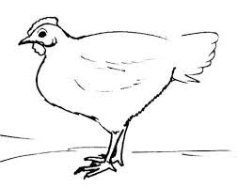
Digestibility of phosphorus
TiO₂ – indigestible marker in the feed
  Will be present in the ileal digesta and faeces
Digestibility of nutrients can be calculated
Feed
Nutrient absorption
Nutrient absorption
Faeces & urine
Faeces & urine
Feed
Notes:
In all feeds, Titanium dioxide was added as an indigestible marker.
This component will not be digested by the animal, thus present in the ileal digesa and faeces.

Slide 23
Analyses and Calculations
Feed, digesta and faeces were analysed for dry matter (DM), crude protein (CP), TiO₂, Ca and P
Ileal apparent digestibility (IAD) and total tract apparent digestibility (TTAD) for the diets:
IAD/TTAD % = 100-[100×(Ti_{feed} × NC_{digesta/faeces})/(Ti_{digesta/faeces} × NC_{feed})]
Content of pre-caecal digestible P (pcdP) in the diet:
pcdP (g/kg of diet) = IAD (%) × P content diet /100
Notes:
Ileal apparent digestibility and the total tract apparent digestibility for the diets were calculated with this equation
That is: the ratio of the difference of the ingested and ileal/fæcal P to the ingested P, expressed as a percentage
According to the literature, the method to determine the ileal digestibility for chickens, the pre-caecally digestible P should be put in relation to the total P content in the diet
– thus, this was needed to be calculated
pcdP is the proportion of the dietary total P that is not recovered in terminal ileum
- thus pcdP is the part that is actually available for the chicken to utilize.

Slide 24
Statistics
Mixed procedure in SAS to determine treatment effects by ANOVA
Models included Diet (fixed factor), Pen or Pig (random factor)
Chicken study included an intercept multiple regression analysis between total phosphorus contents and the pcdP in the diets with the GLM procedure
Level of significance: P<0.05
Notes:
The statistical models were run with mixed procedure
The literature suggest to include regression analysis to the statistical model showing the linearly relationship between the digested P to the total content of P in the diet.
This is then used to estimate the ileal apparent digestibility of phosphorus for the P-source tested.

Slide 25
Results Chicken Study
– ileal apparent digestibility % of nutrients in diets
 | Basal | PCP Low | MCP Low | PCP High | MCP High | SE | P-value
OM | 73.43 | 73.73 | 74.41 | 75.76 | 75.60 | 0.770 | 0.150
Ca | 59.03 | 55.13 | 58.13 | 54.71 | 55.34 | 2.196 | 0.535
P | 41.91^{ab} | 40.28^{b} | 42.64^{ab} | 44.16^{ab} | 48.27ª | 2.007 | 0.022
PcdP | 1.61^{b} | 1.67^{b} | 1.79^{b} | 2.16ª | 2.43ª | 0.094 | 0.001
Notes:
The IAD (%) of OM and Ca did not differ between diets whereas the IAD of P and PcdP (g/kg DM) differed between the diets with low and high P inclusion.
PcdP (Pre-caecally digestible P) is the proportion of dietary total P that is not recovered in the content of the end of ileum. That is the P that is actually available for the chickens.

Slide 26
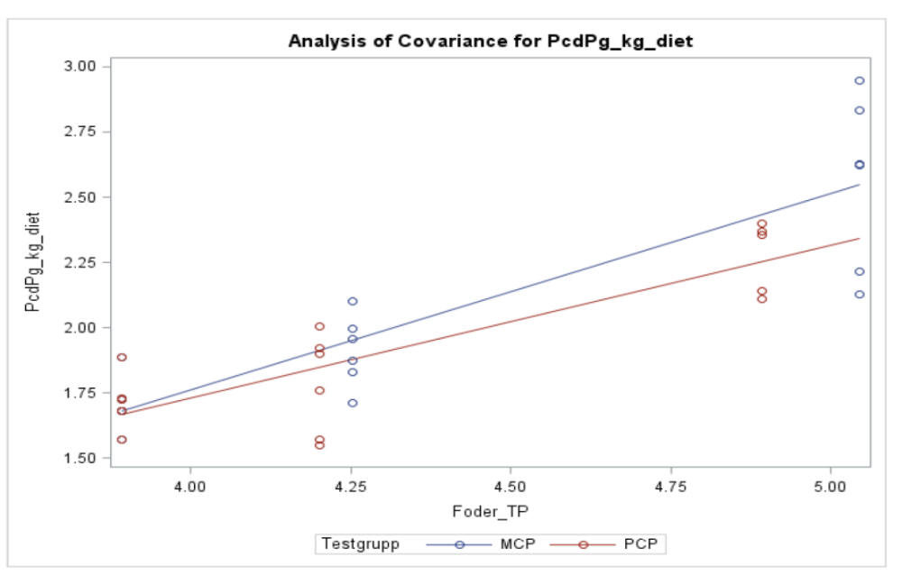
Results Chicken Study
- Linear relationship between pcdP content and total P
MCP high
PCP high
MCP low
PCP low
Basal
Notes:
Illustrated in this figure, showing the linearly relationship between the pcdP (g/kg diet) and the total P content in the diet.
It is expected to be more digested P (pre-caecally) with higher level of total P in diet.
And from this relationship the ileal apparent digestibility from P (from the two sources MCP and PCP – was estimated to be 75.1% (MCP) and 58.4% (PCP).

Slide 27
Results Chicken Study
- Ileal Apparent Digestibility of P
 | Regression equation | SE of slope | SE intercept | r2 | Ileal digestibility %
MCP | Y=0.751-0.638 | 0.142 | 0.620 | 0.770 | 75.1
PCP | Y=0.584-0.603 | 0.110 | 0.475 | 0.770 | 58.4

Slide 28
Results Pig Study
– total tract apparent digestibility % of nutrients in diets
 | PCP | MCP | SE | P-value
OM | 93.96 | 94.23 | 0.244 | 0.348
Ca | 58.46 | 71.30 | 2.292 | 0.001
P | 60.39 | 83.81 | 2.587 | 0.001

