Slide 1


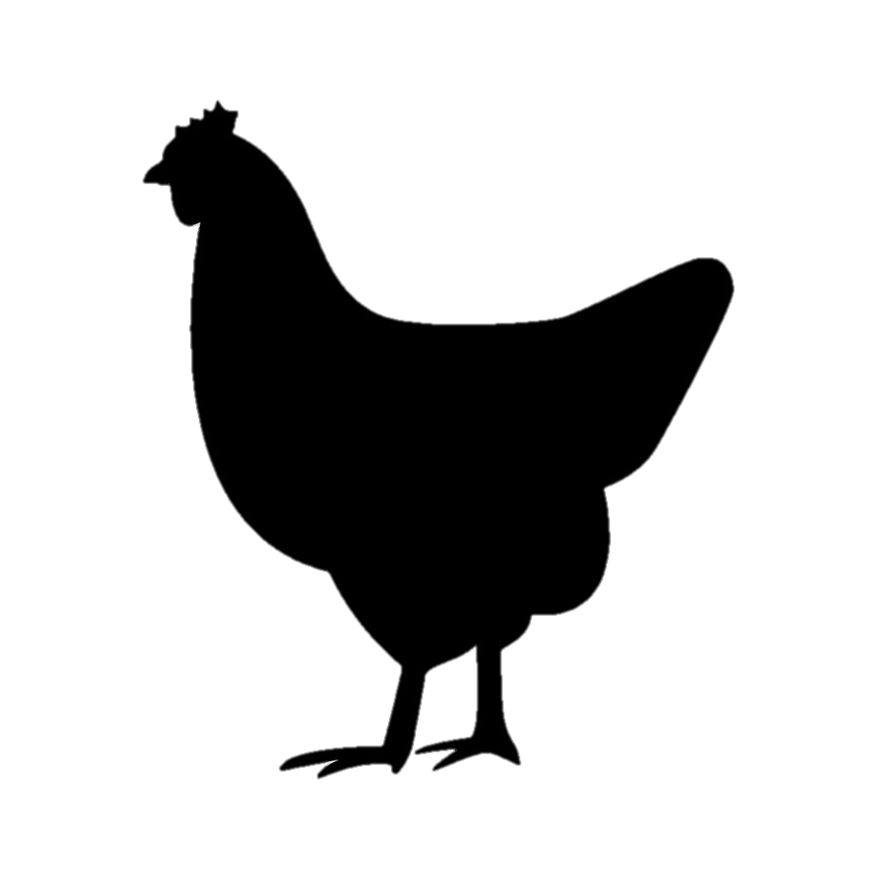






Circular Flanders: using poultry wastewater to cultivate microalgae
Peter Bleyen
Floris Schoeters
31/03/2022

Slide 2
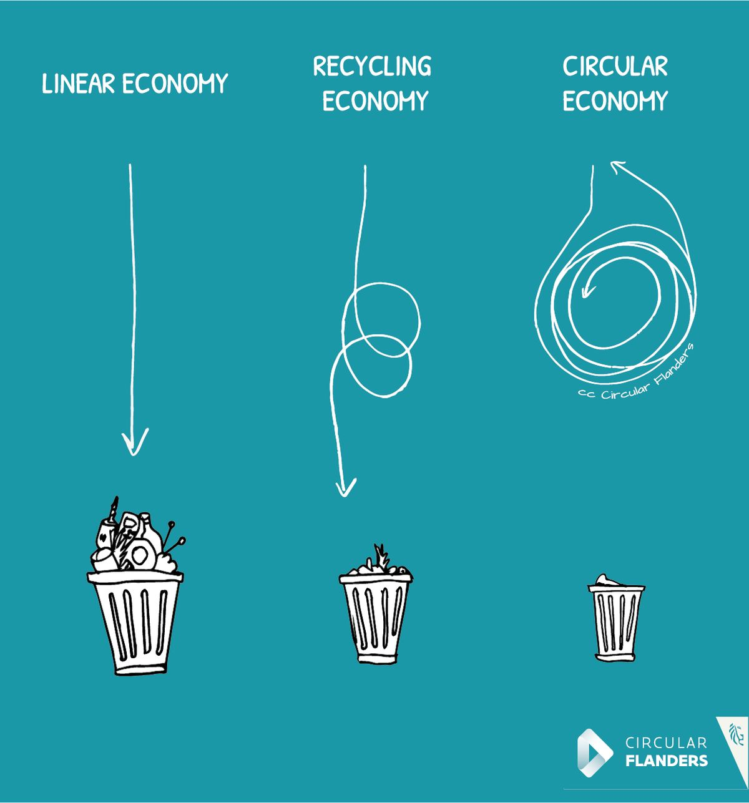
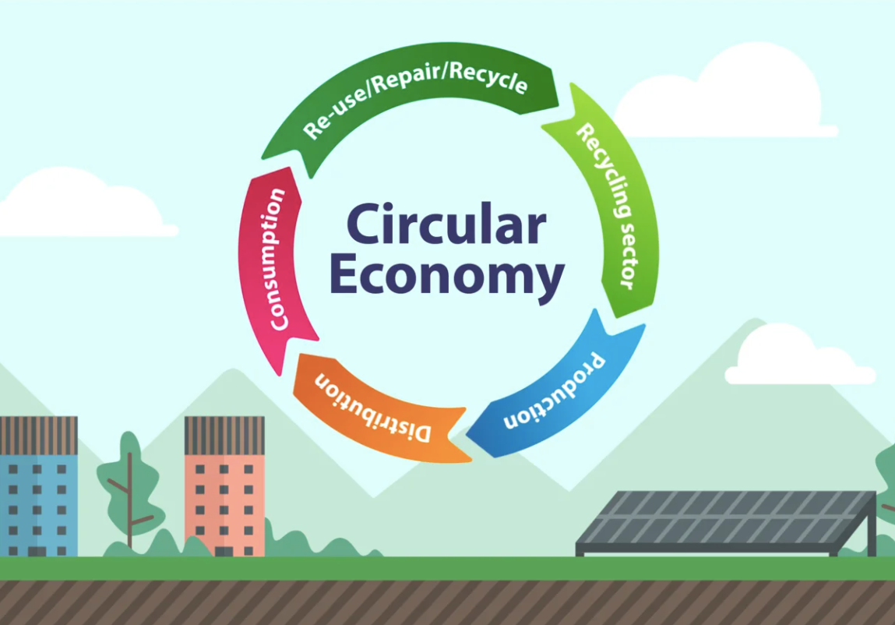
Circular economy
The transition to a carbon neutral, more resource-efficient one
To close the loop of product lifecycle by up- and recycling and re-use
Benefits for both the environment and the economy

Slide 3
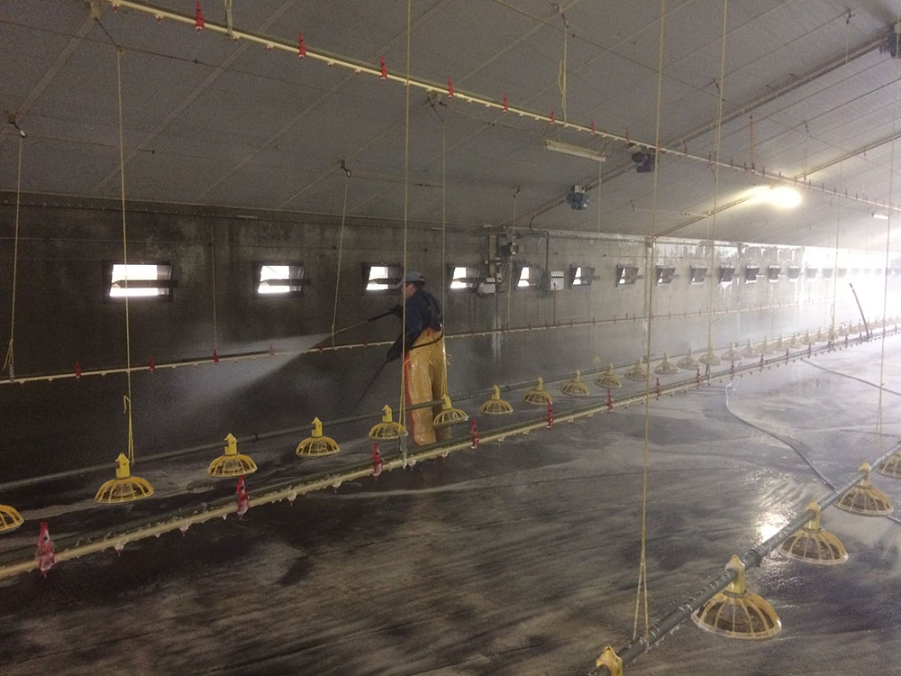
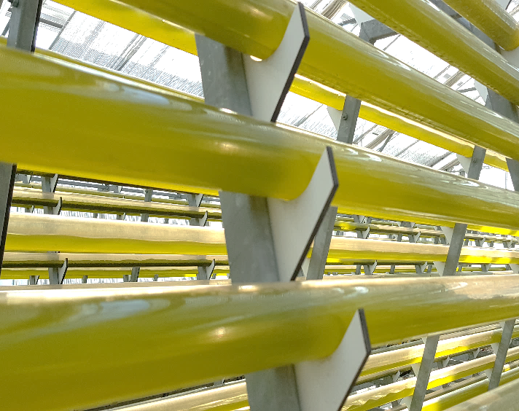
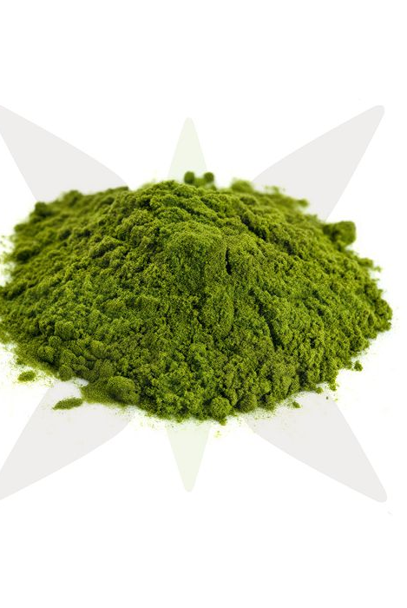
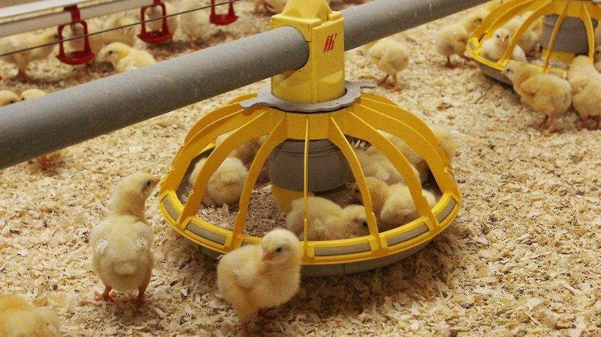

Circular Flanders: algae grown in poultry farm wastewater
Introduction
Water used to clean poultry stables (N and P rich) => algae => feed for chicken
(Liquid manure)

Slide 4
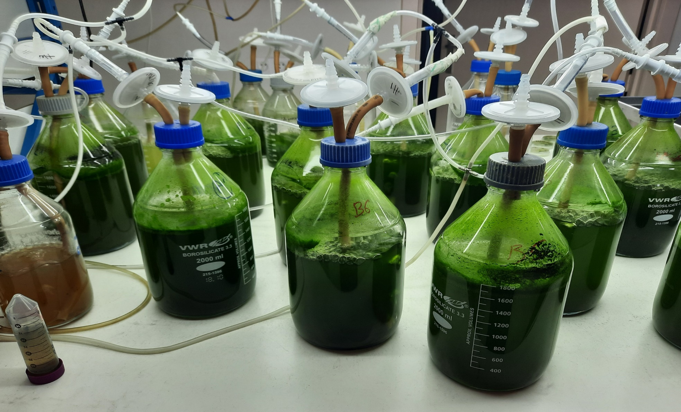
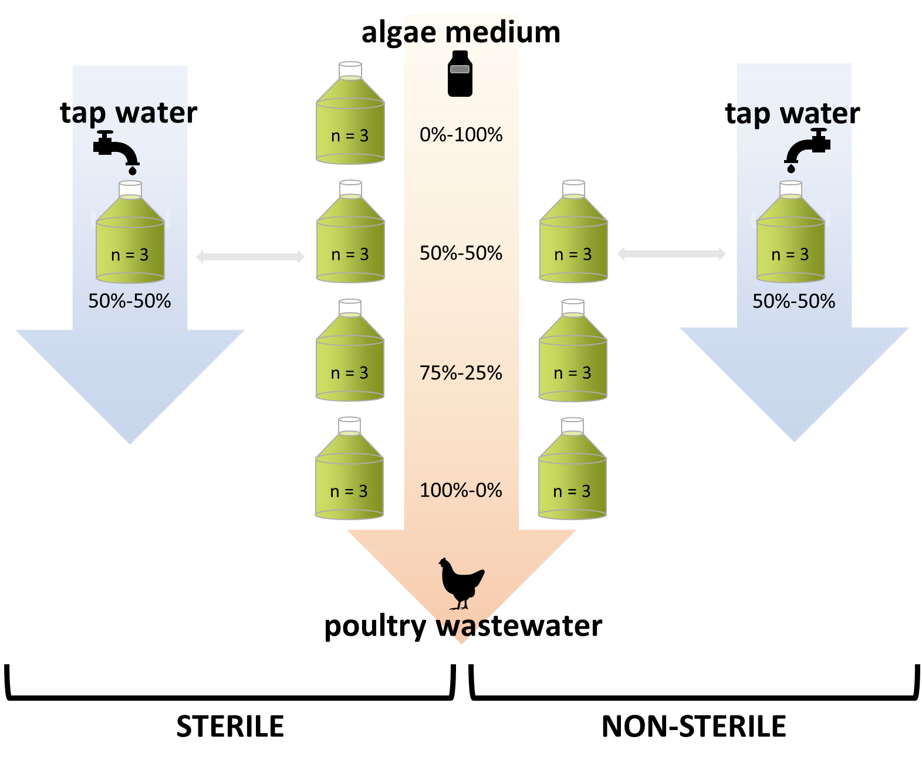
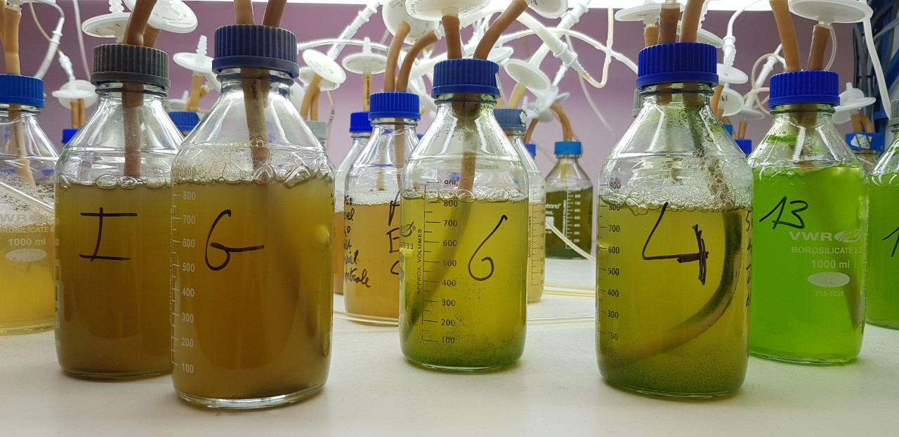

Slide 5
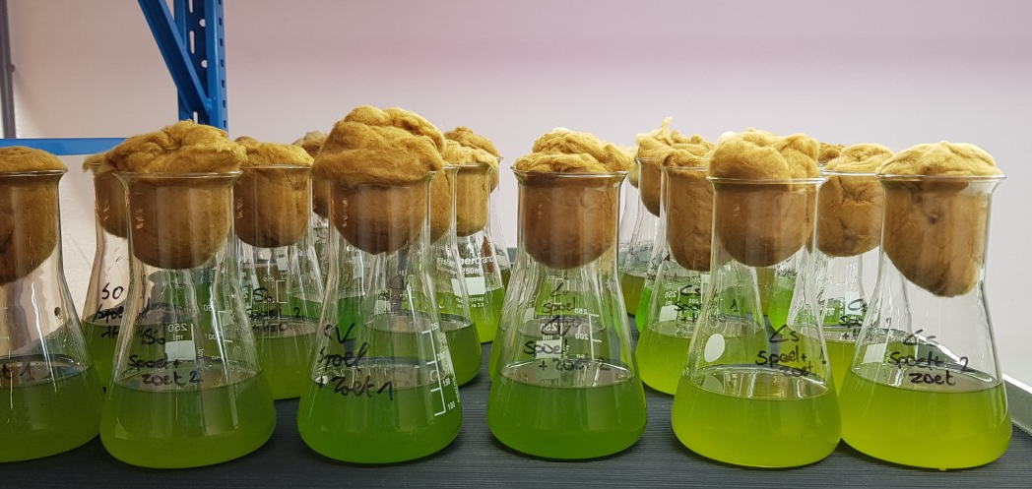

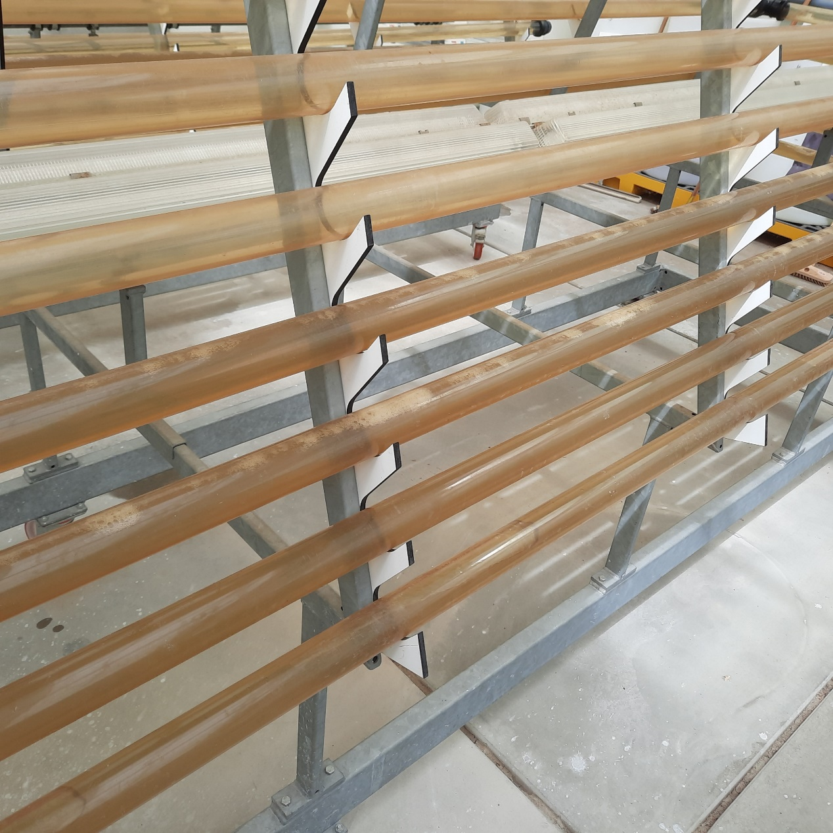
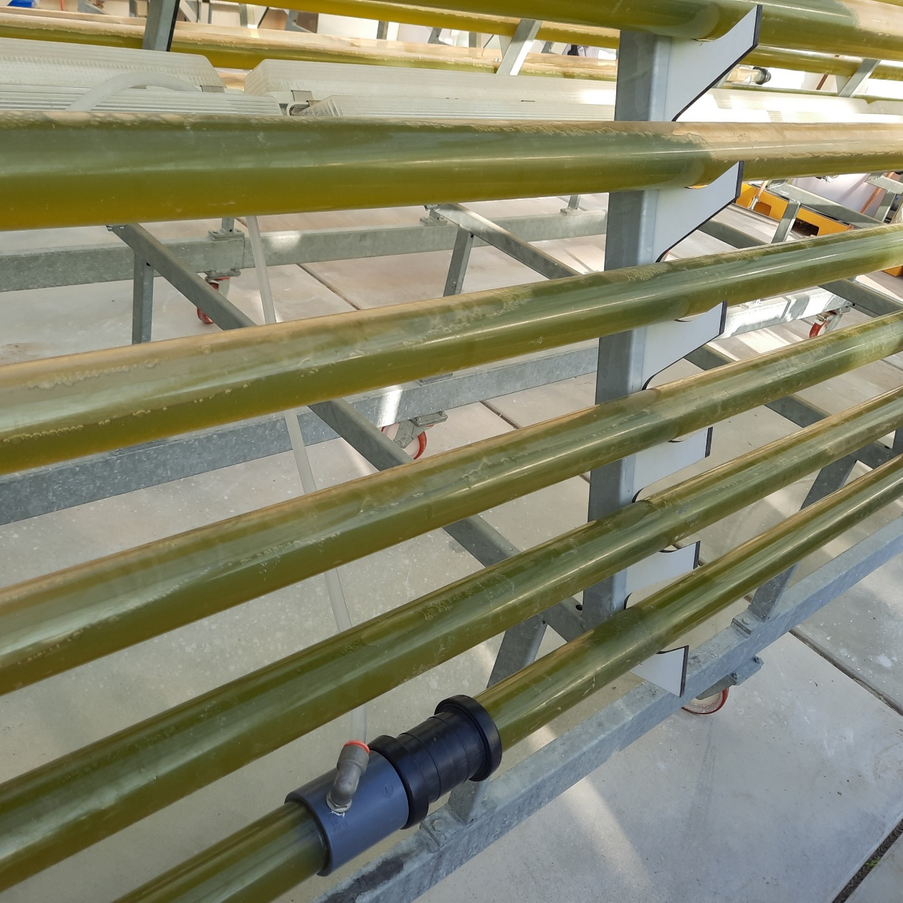
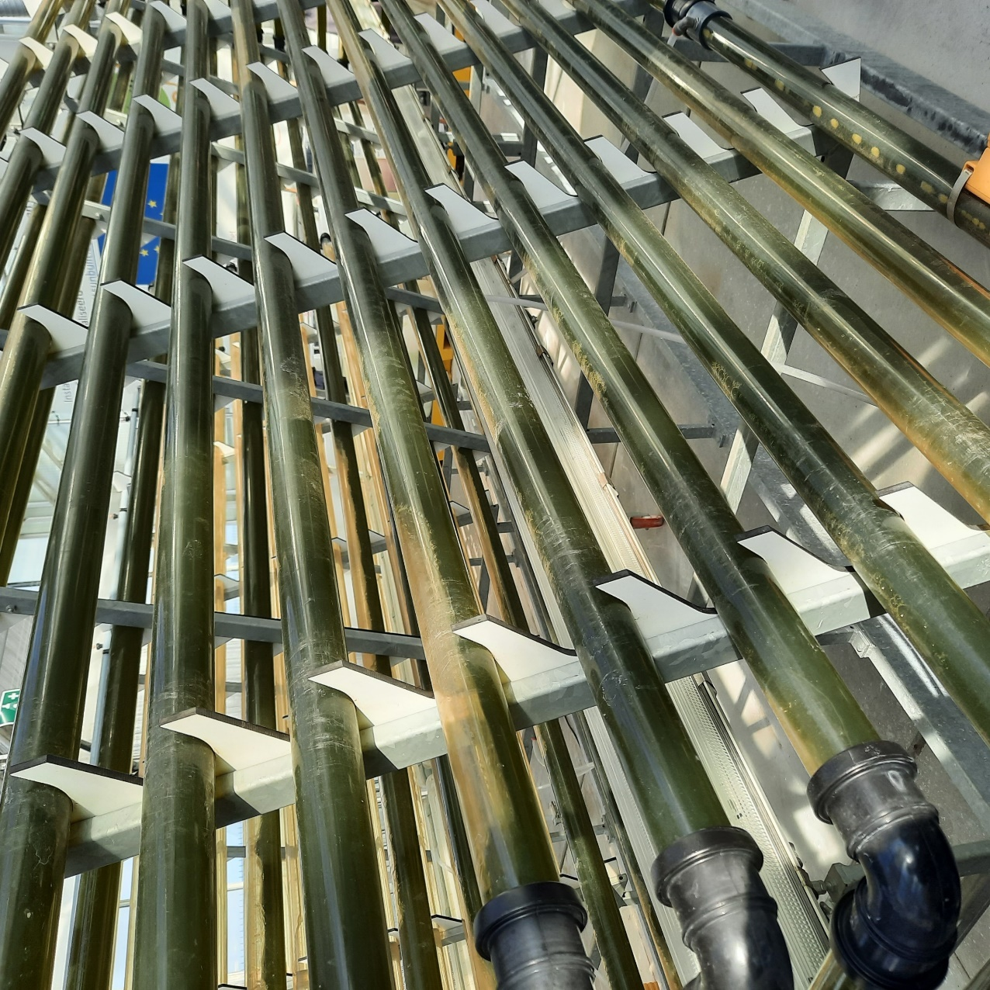
From lab-scale to pilot scale
Chlorella Sorokiniana
vs
Scenedesmus obliquus

Slide 6
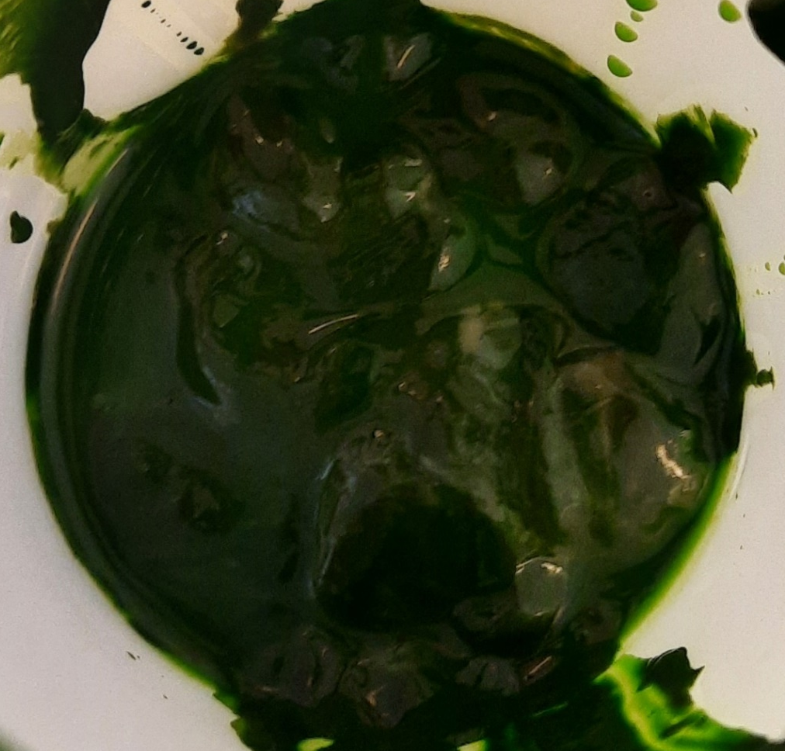
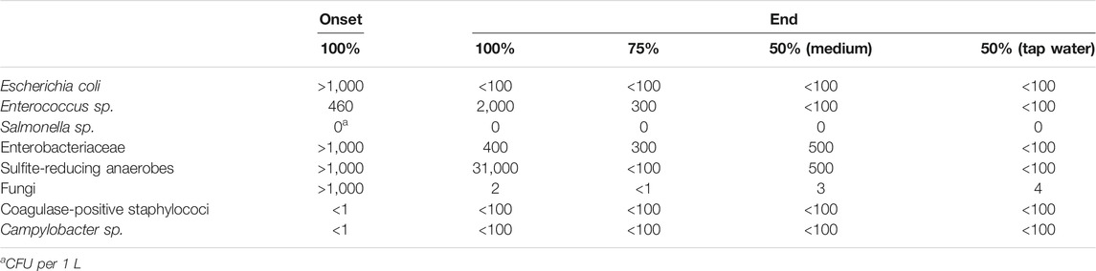
Analysis microalgae grown in poultry cleaning water
 |  |  | Algaepaste (mg/kg) |  |  | Algaepaste (mg/kg) |  |  | Algaepaste (g/100g) | Dry matter (%)
(heavy) metals |  |  |  | Aminoacids |  |  | Macro-nutrients / Weende
 |  | Fe | 173 |  | Threonine + Arginine | 5160 |  | Moist | 79,8 | ̴ 5
 |  | Cu | 21 |  | Aspartic acid | 4150 |  | Anorganic content | 2,23 | ̴ 9
 |  | Cd | 0,037 |  | Glutaminic acid | 4380 |  | Total protein content | 4,90 | ̴ 20
 |  | Pb | 0,33 |  | Serine | 1750 |  | Starch | 4 | ̴ 16
 |  | Zn | 101 |  | Histidine | 795 |  | Fibers | 0,49 | ̴ 2
 |  | As | 0,12 |  | Glycine | 3260 |  | Total lipid content | 4,2 | ̴ 17
 |  | Cr | 0,62 |  | Alanine | 3640 |  | Total carbohydrates | 8,8 | ̴ 35
 |  | Ni | 0,39 |  | gamma-aminobutyric acid | 256
 |  | Hg | 0,011 |  | Tyrosine | 1040
 |  |  |  |  | Valine | 2640
 |  |  |  |  | Methionine | 1230
 |  |  |  |  | Isoleucine | 2460
 |  |  |  |  | Phenylalanine | 3680
 |  |  |  |  | Leucine | 3790
 |  |  |  |  | Ornithine | 117
 |  |  |  |  | Lysine | 2500
Pathogens CFU
Chlorella sorokiniana grown in 50% poultry wastewater
No added nutrients/CO₂
120 g algaepaste from 20 liter

Slide 7
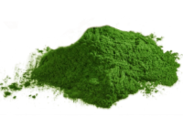
Algae → chicken feed
‘Closing the loop’: cleaning waste water → algae → chicken feed
Feed trail: supplementation of algae in broiler feed
Regulatory obstacle:
  waste water = manure
  EU 767/2009 Art 6.1 and Annex III: “Exclusion of materials derived from manure, irrespective of any form of treatment”
Commercial algae product: Chlorella sorokiniana

Slide 8
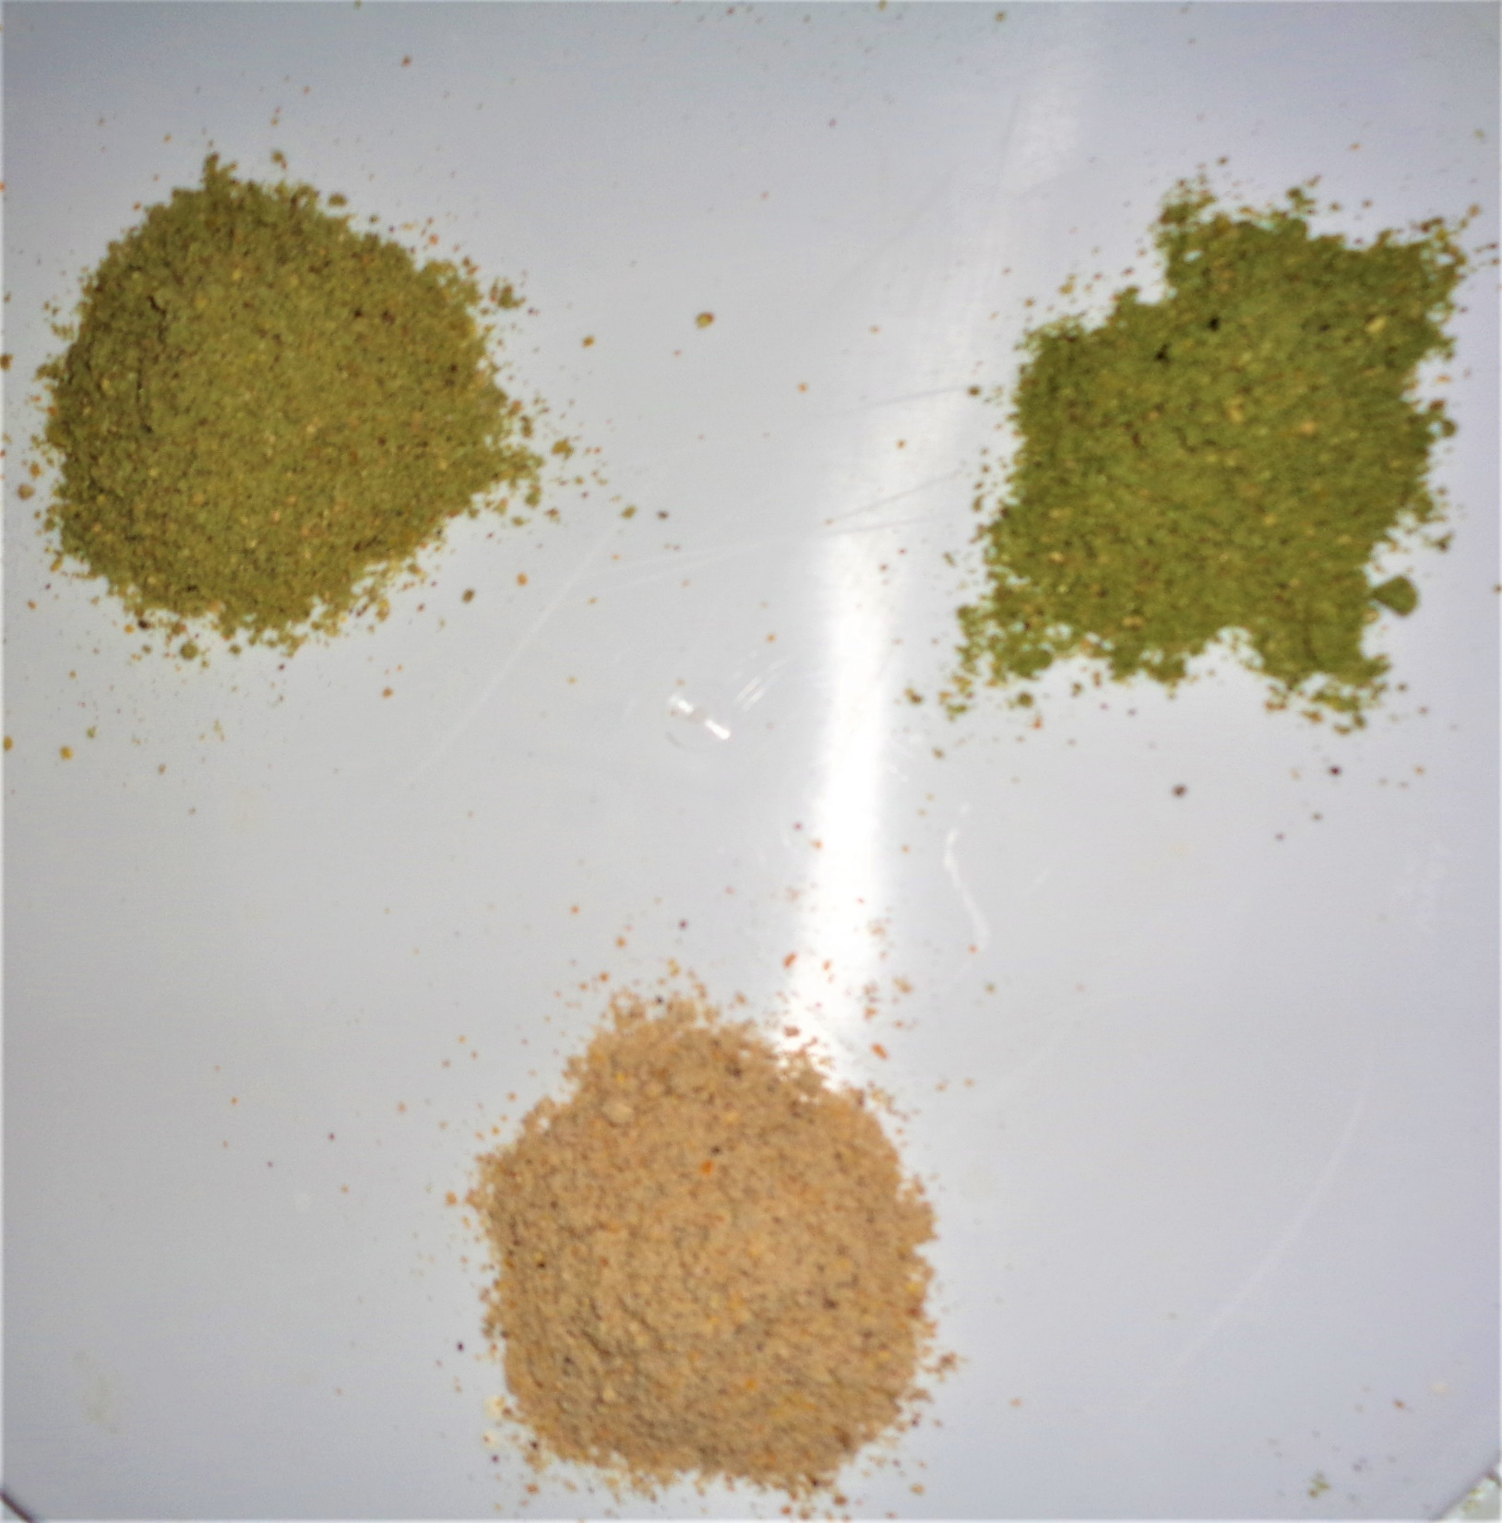
Experimental design
Treatment | Ross308 broilers
Treatment 1: control mash feed (starter – grower – finisher) | 2 x 20 females + 2 x 20 males = 80
Treatment 2: control + 5% algae (Chlorella sorokiniana) | 2 x 20 females + 2 x 20 males = 80
Treatment 3: control + 10% algae (Chlorella sorokiniana) | 2 x 20 females + 2 x 20 males = 80
 | Total = 240
+5% algae
+10% algae
Control feed

Slide 9
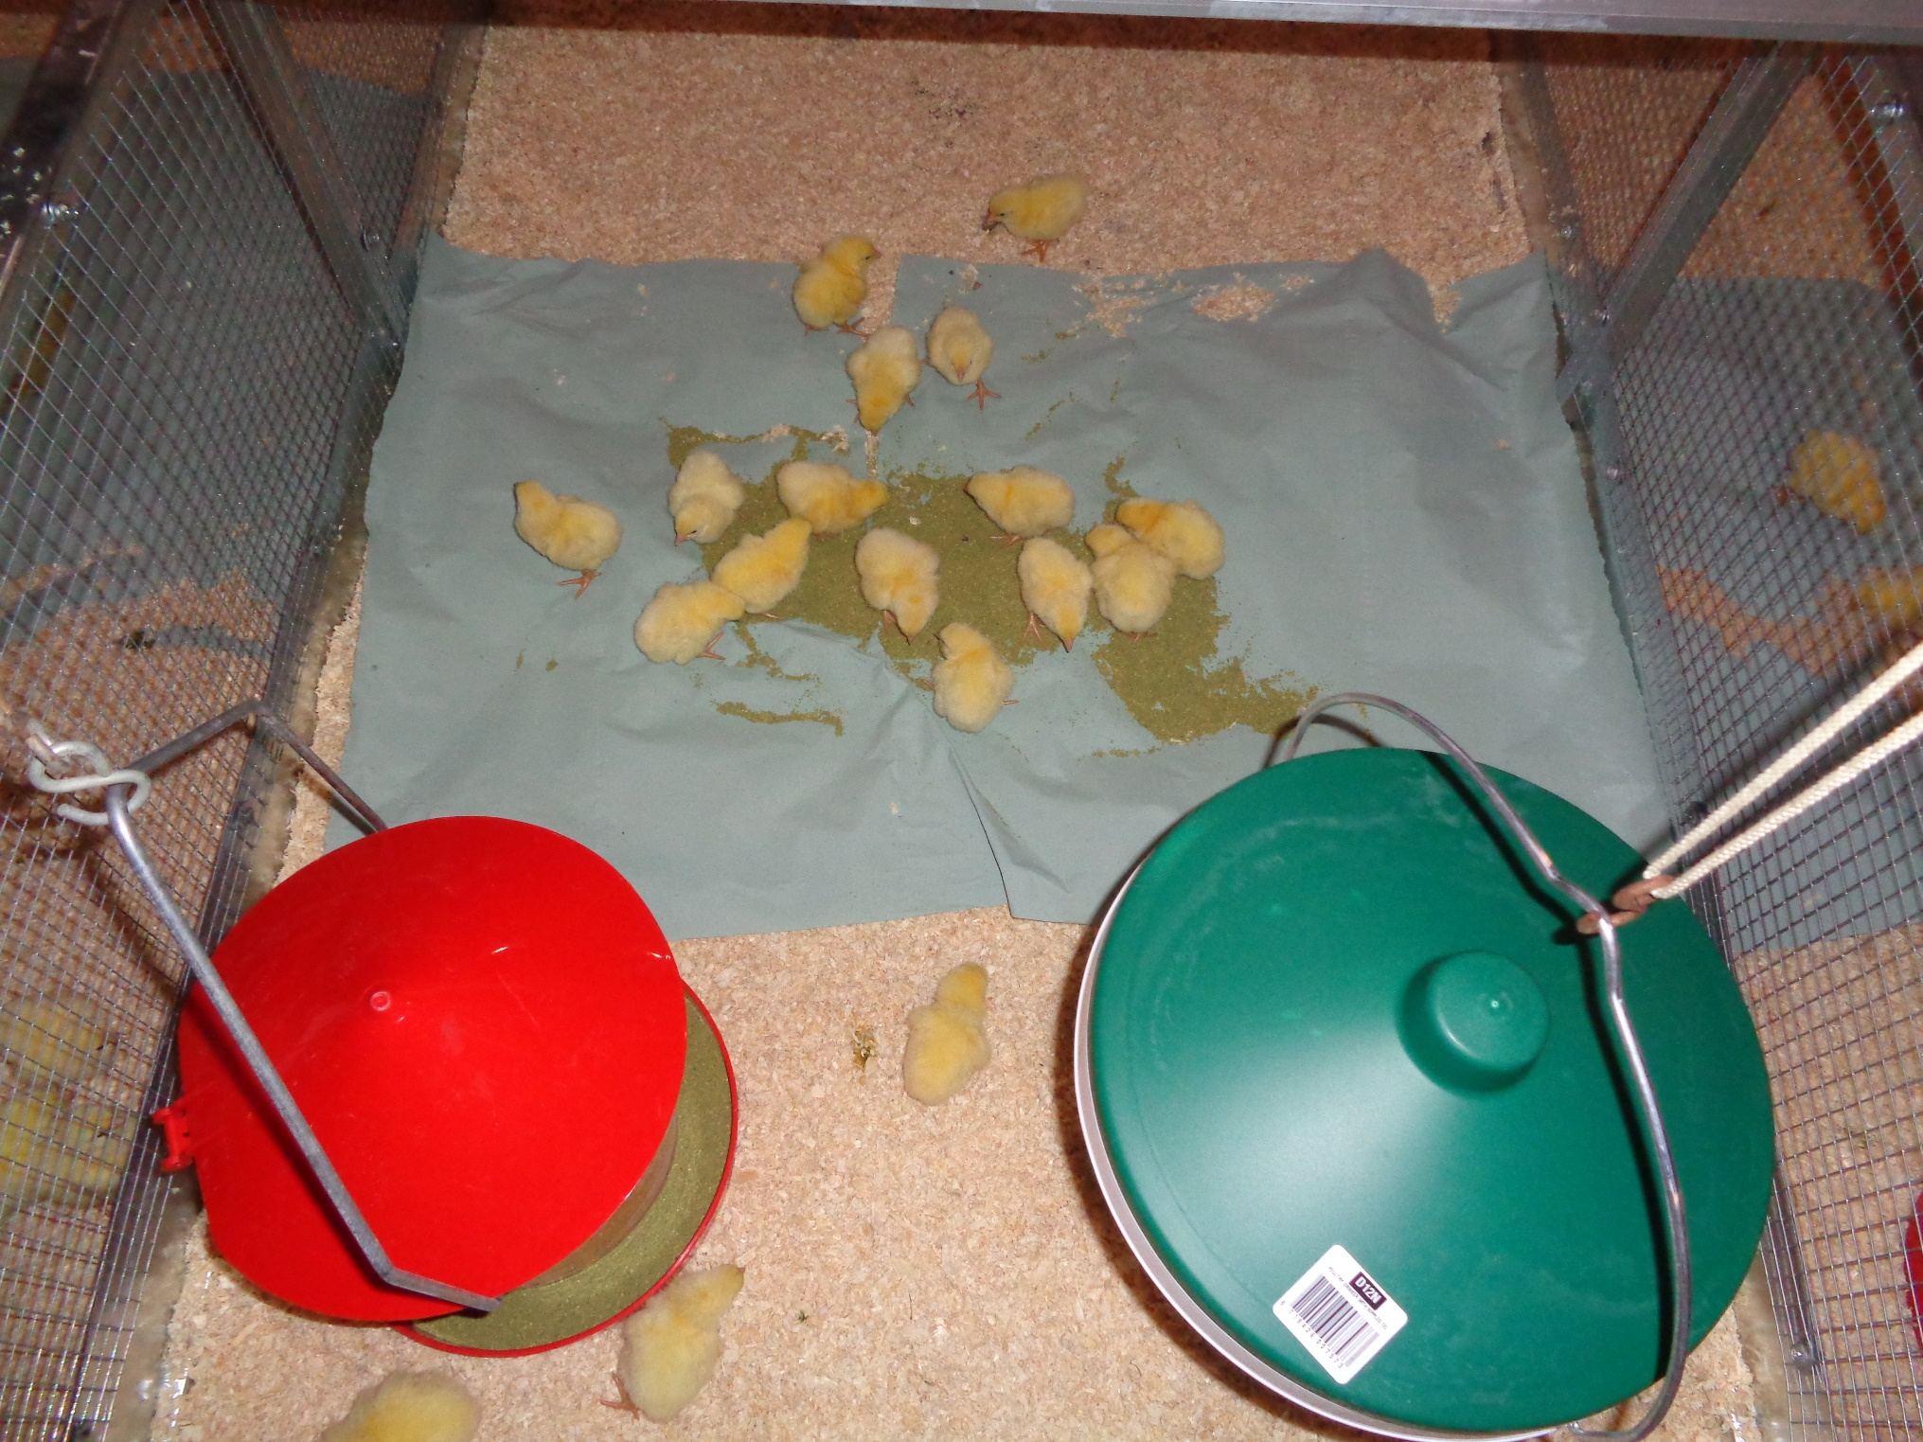
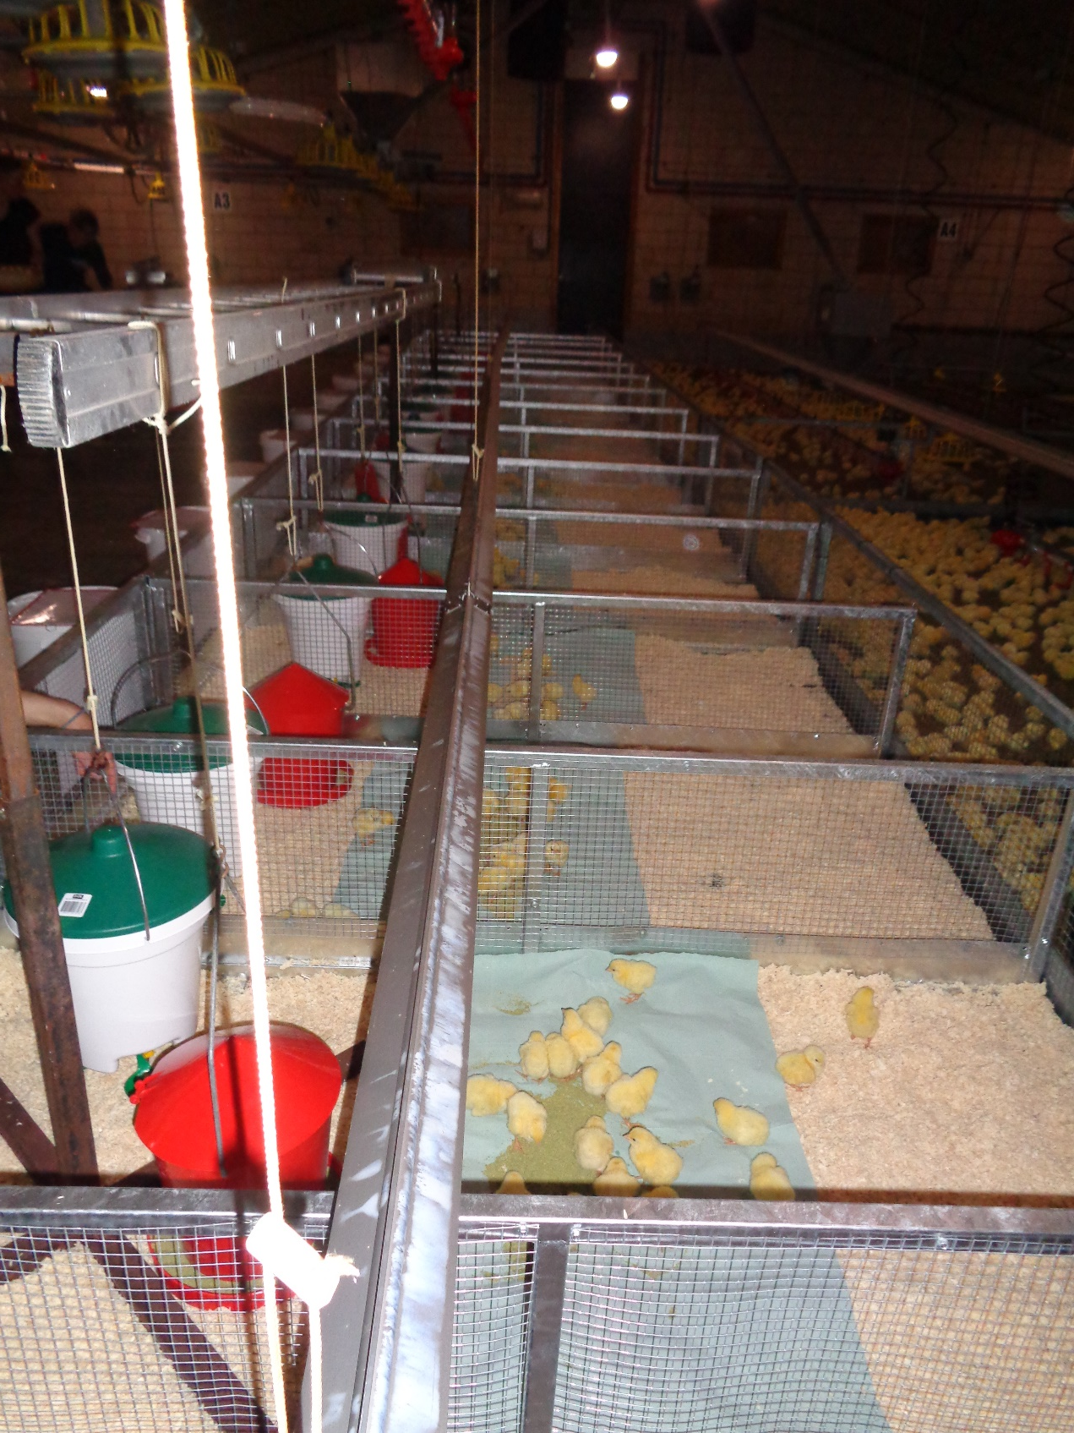
Experimental design

Slide 10
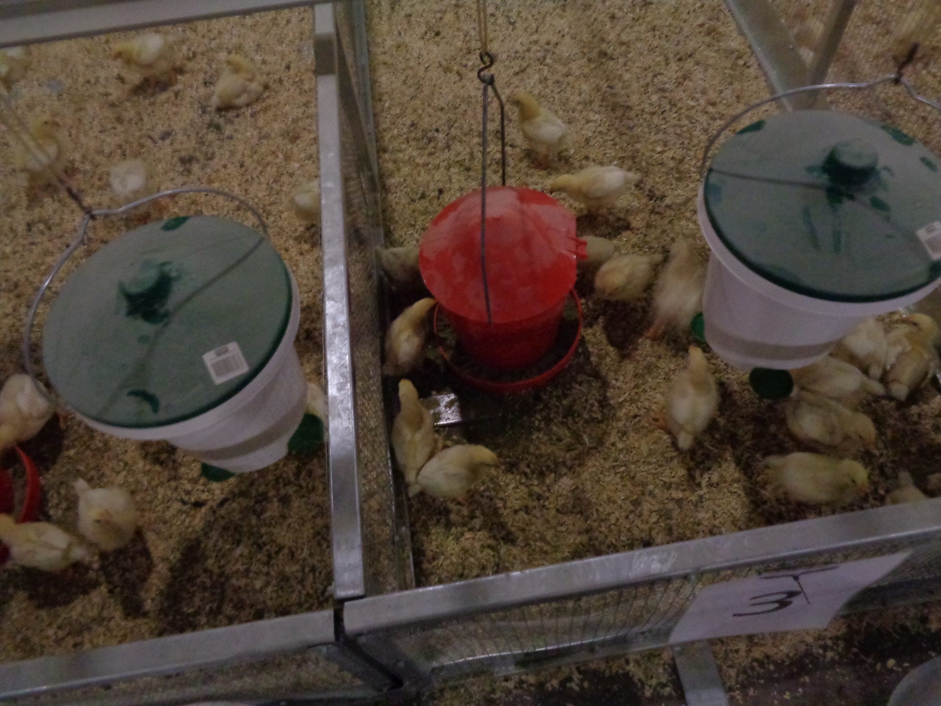
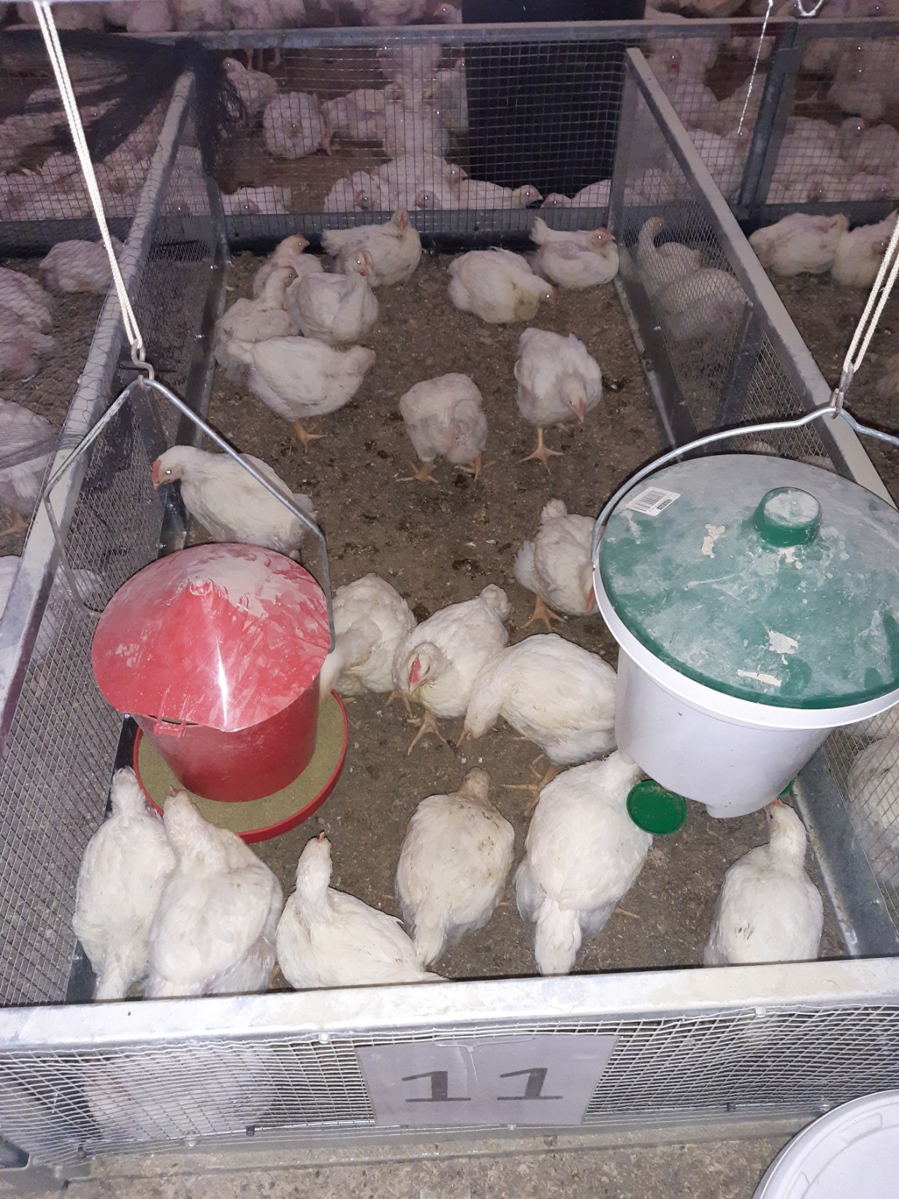
Experimental design

Slide 11
Technical results
  Daily feed intake lower with algae supplementation
  Lower daily growth and live weight
  No difference in feed conversion rate
  No effect on daily water intake and water/feed-ratio

Slide 12
Feather cleanness – hock and feet lesions

Slide 13
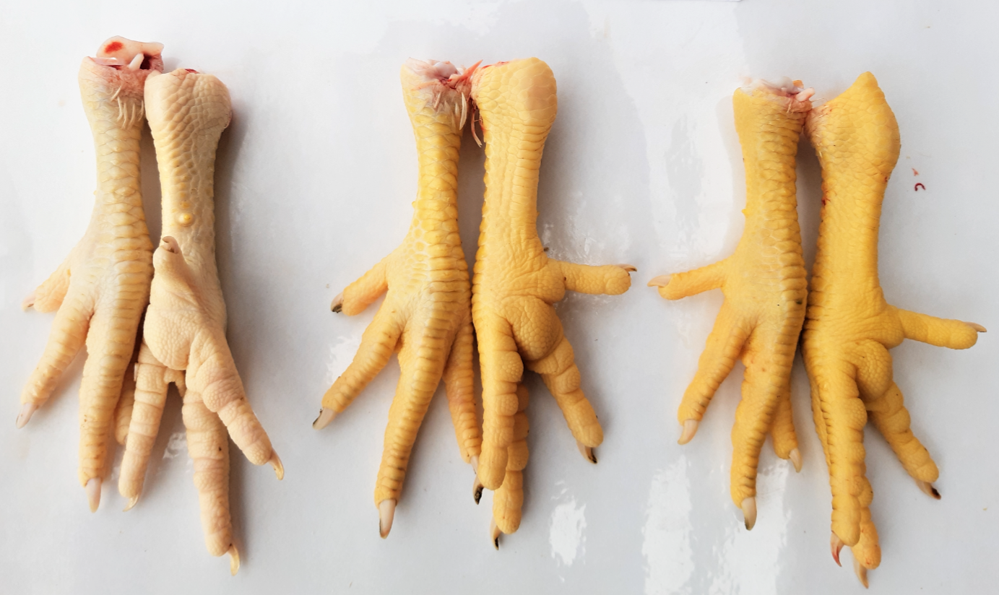
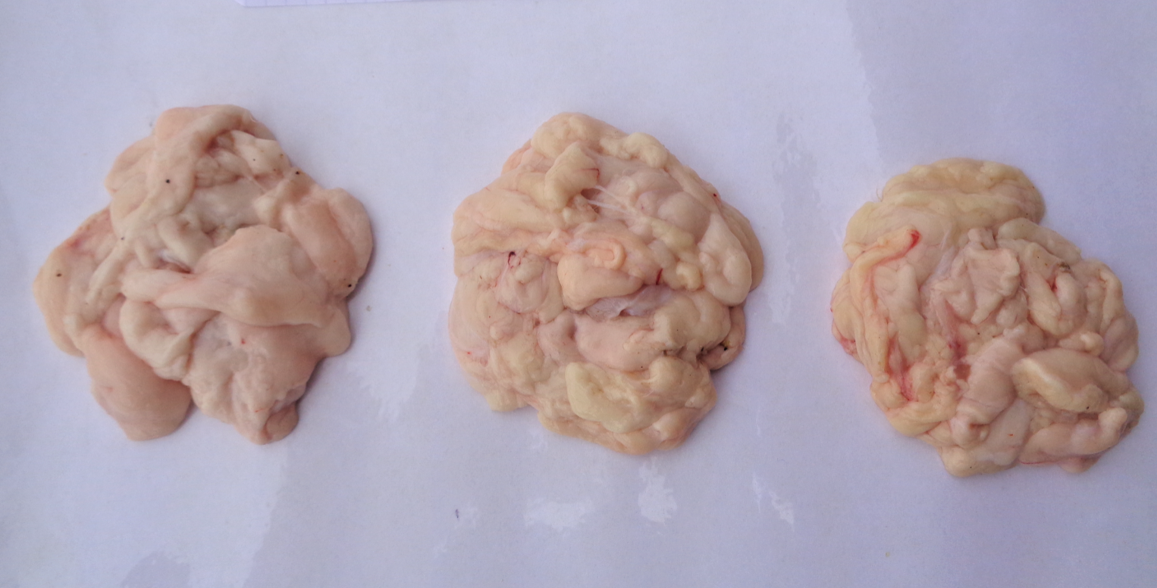
‘Discoloration’
Carotenoïds in the algae
- chicken feet
- abdominal fat
control
+5% algae
+10% algae
control
+5% algae
+10% algae

Slide 14


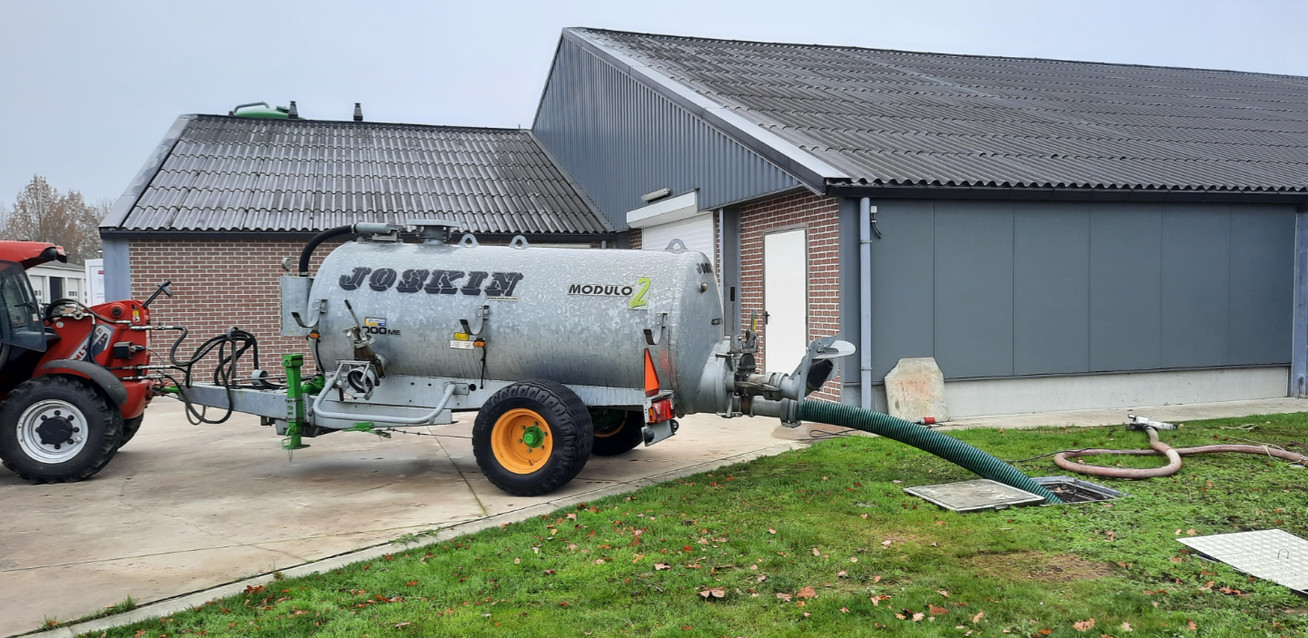
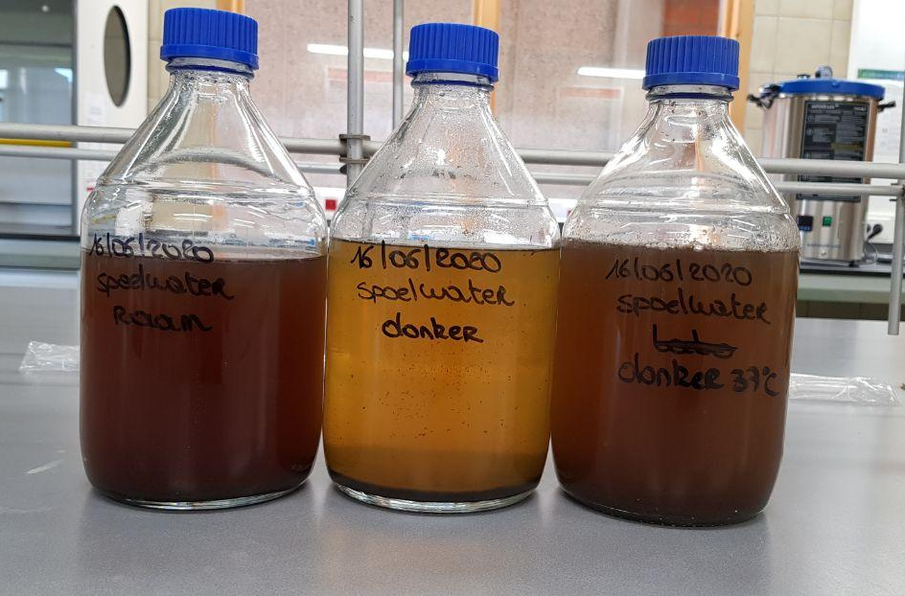
Lessons learned
Potential for algae biomass production from poultry cleaning water (+ waste water treatment)
Pathogenic micro-organisms are reduced
Heavy metals < legal threshold
Algae biomass potentially has a value in animal feed

Slide 15
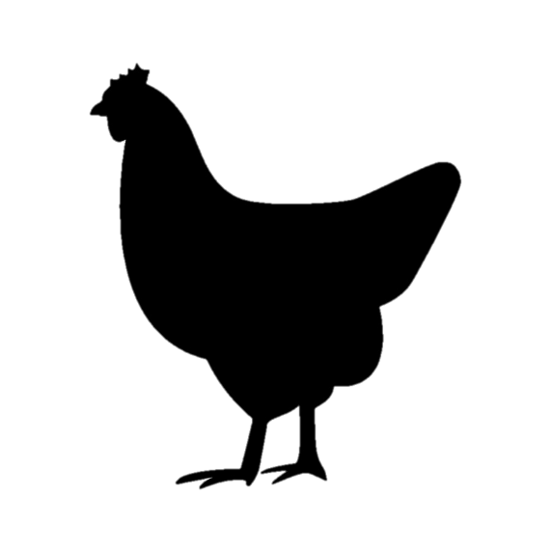

Obstacles and questions
Regulatory blockages: Animal Feed Regulation EU 767/2009 Art 6.1
→ Annex III: ‘… irrespective of any form of treatment or admixture.’
- Lack of knowledge on algae within the legal framework.
High initial set-up costs + production costs hamper the use of microalgae in feed for poultry, pigs
  not ‘bulk protein product’
  functional ingredients
  value of the algae by-products after fractionation?

Slide 16
Thank you for your attention!

