Slide 1


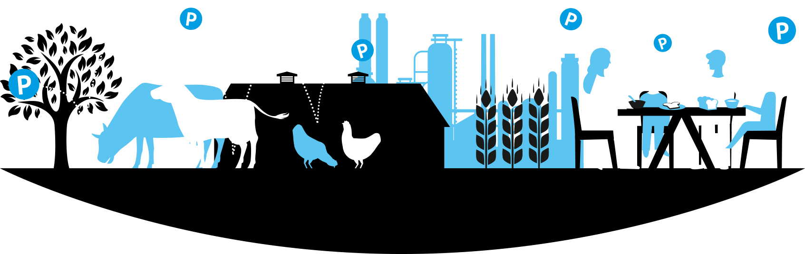
Christopher Thornton, European Sustainable Phosphorus Platform
info@phosphorusplatform.eu

Slide 2
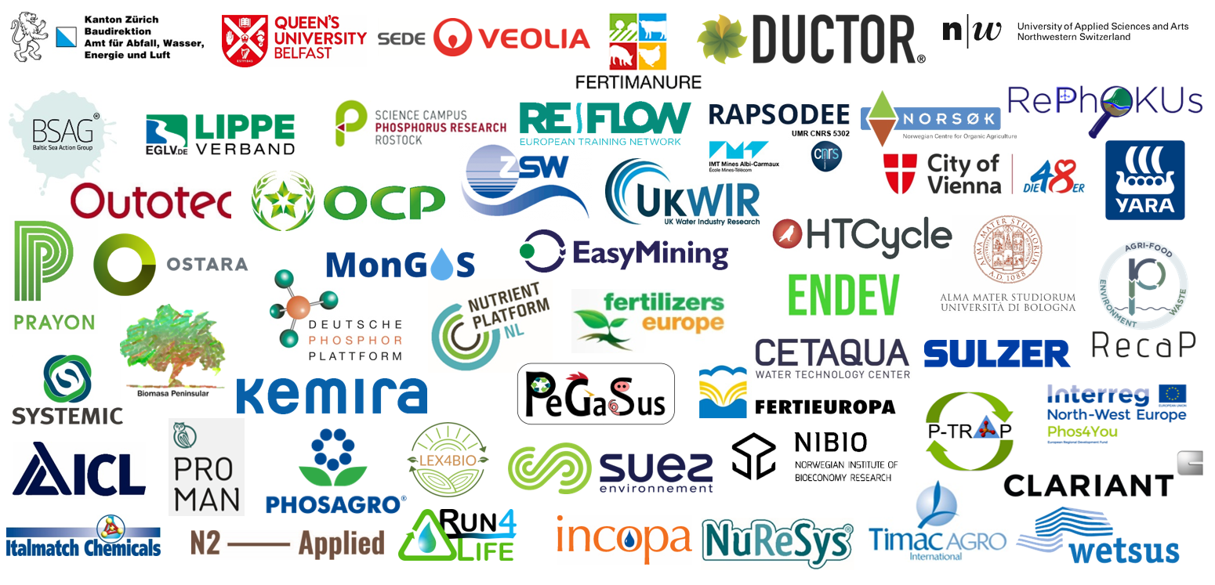
European Sustainable Phosphorus Platform (ESPP)

Slide 3
Some routes for recycling nutrients
from “wastes”to animal feed
Chemical (mineral) recovery :
- P recovery from ash from sewage sludge incineration or bone meal ash
- K recovery from municipal waste incineration ash
- N recovery from ammonia stripping from digestates (sewage sludge, manure)
- N recovery from manure storage or livestock stable offgas
- N recovery from N₂O stripping in sewage works
- N recovery from industrial process offgas treatment
Use of organic waste streams to feed:
- algae, aquatic plants, terrestrial plants
- microbial protein production
- insect production

Slide 4
Potential for recycling nutrients
Phosphorus recycling potential in EU-27
[kton P/year - 2005] | Total | Recycled | Potential
Sewage sludge | 297 | 115 | 182
Biodegradable solid waste | 130 | 38 | 92
Meat & bone meal | 128 | 6 | 122
Total | 427-555 | 153-160 | 274-396
Manure = 1 800
Mineral phosphorus fertiliser use = 1 450 ktP/y
Based on: Van Dijk, Lesschen & Oenema "Phosphorus flows and balances of the European Union Member States.“ Sci Tot Env 2016 https://doi.org/10.1016/j.scitotenv.2015.08.048

Slide 5
Potential for recycling nutrients
From municipal wastewaters:
- 70 000 t/y phosphorus (as P) and 70 000 t/y nitrogen (N)
- 210 000 t/y dry mass algae
https://www.eureau.org/resources/news/606-valuing-our-recyclable-materials
For chemical phosphorus recovery:
- similar potential from animal by-products (via ash) plus food waste, food industry
From manures:
Total potential maybe 10x more
Potassium from solid municipal refuse

Slide 6
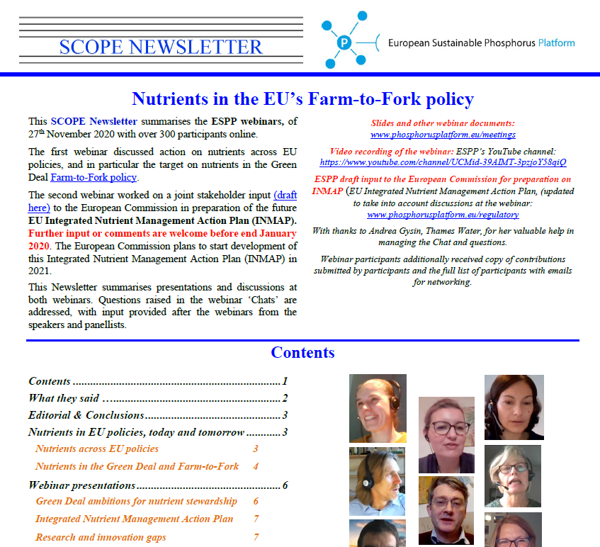
ESPP actions
Vision & awareness:
- network of members, scientists, regulators, companies
- 65 000 emailing list worldwide
Stakeholders & networking
Policy and regulation dialogue
- enable dialogue between different industry sectors, science
- develop shared proposals for policy
- communicate with regulators
- regulatory obstacles to recycling (e.g. in animal feeds)
- safety - EFSA
- food and diet, Farm-to-Fork, nutrients policy
(INMAP consultation open to 26/4/22)
- policies to support recycling:
- Circular Economy
- Critical Raw Materials (phosphate rock)
- “Taxonomy” (criteria for green investment funding)
- links to carbon credits, greenhouse policy …

Slide 7

4th European Sustainable Phosphorus Conference
5th PERM Phosphorus in Europe Research Meeting
Nutrient Recovery Technology Fair
https://phosphorusplatform.eu/espc4

Slide 8
Christopher Thornton, European Sustainable Phosphorus Platform
info@phosphorusplatform.eu

