Slide 1
Webinar on Circular Feed: The future potential of nutrient recovery through animal nutrition

Slide 2


Slide 3
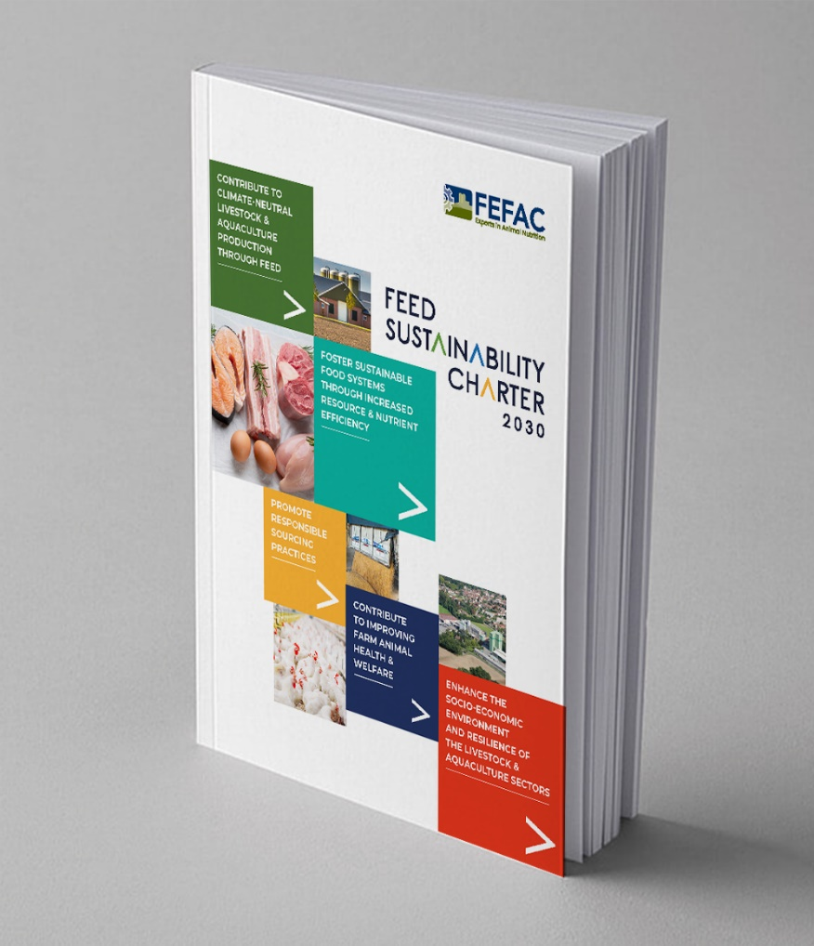
Feed sustaINABILITY CHARTER 2030
Contribute To Climate-Neutral Livestock & Aquaculture Production Through Feed
Foster Sustainable Food Systems Through Increased Resource & Nutrient Efficiency
Promote Responsible Sourcing Practices
Contribute to Improving Farm Animal Health & Welfare
Enhance the Socio-Economic Environment and Resilience of the Livestock & Aquaculture Sectors

Slide 4

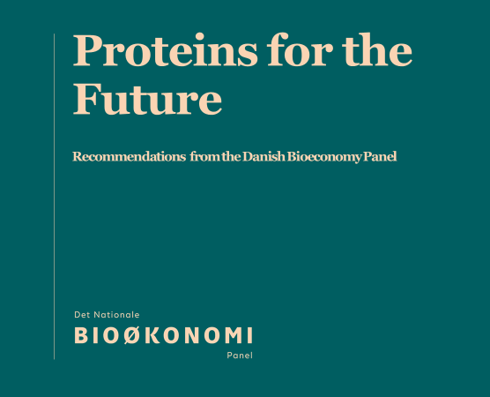
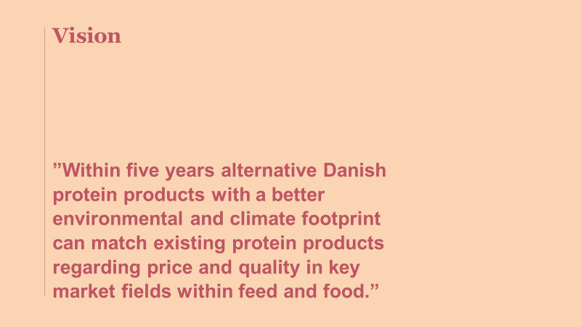
The Danish National Bioeconomy Panel
Consists of 20 representatives from academia, ngos, trade union, associations and private companies. Supported by a cross ministerial secretariat
Next task is on a rather general level: “The role of bioresources in green transition”
2018: the panel launched a report on proteins for the future

Slide 5
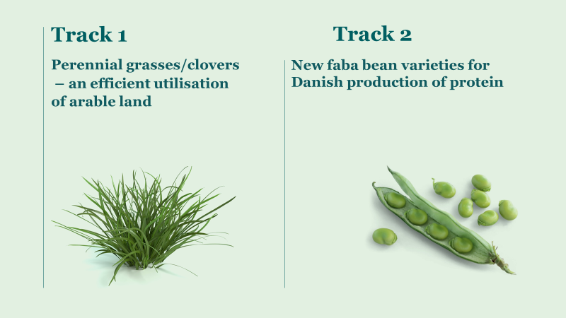
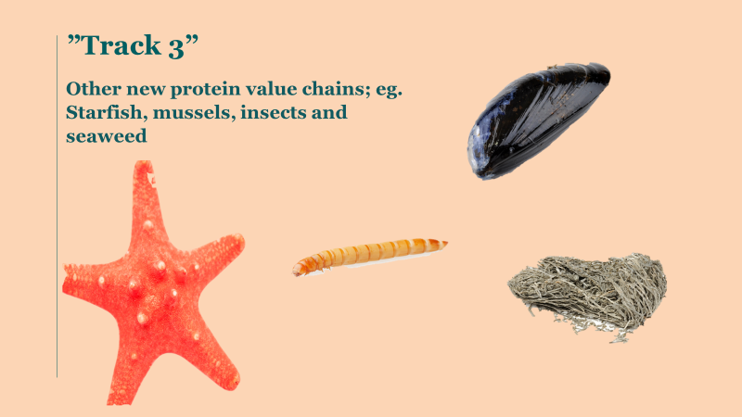
Examples on track that has been advanced into concrete production since 2018

Slide 6
Danish protein supply in the future
Track | Biomass | Hectares | Volume of protein (t) | Barriers
1 | Grasses and clovers | 100.000 | 100.000 | TRL*, protein quality
2 | Legumes | 100.000 | 100.000 | Plant breeding
3 | Seaweed, starfish and mussels | - | 15.000 | TRL lack of areas for production sites
 | Microbes, bacteria and insects | - | 25.000 | Regulation, TRL
 | Blood | - | 10.000 | Cost of handling and processing
 | Sidestreams from oil, flour, mash and starch | - | 50.000 | TRL
 |  |  | 300.000
* = Further advancement in Technology Readiness Level
Notes:
To sum-up on the three tracks: Here are the potentials to meet the target of substituting 1/3 of the imported soy proteins with new and more sustainable Danish protein sources:
(gennemgå de tre tracks overordnet)
To make this happen we need to overcome some barriers:
Some have to do with technology readiness levels – research and innovation is needed!
Protein quality – and digestibility – fx grass protein to pigs… (processing and plantbreeding)
Handling of the biomass to make it profitable
Protein crops – here we need new improved varieties – let me give you an example here… (skift til næste slide)

